Slide 1
Userguide
One Trust
Highly Confidential

Slide 2
SUMMARY
01
INTRODUCTION
02
WEBSITE SCANNING
03
COOKIES MANAGEMENT
04
COOKIE BANNER
05
GEOLOCATION RULES
06
SCRIPTS

Slide 3
01.
INTRODUCTION
One Trust interface
Summary

Slide 4
LOGIN
One Trust URL:
https://bnp.my.onetrust.com
To have access please create a Jira ticket:
https://reman.intra.corp/
Projet:
Apollo Site Factory (APO)

Slide 5
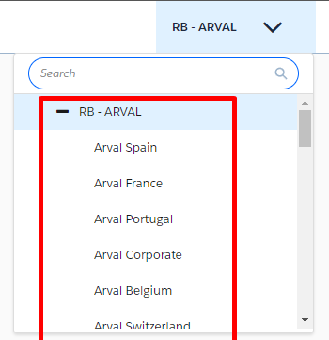
ORGANIZATION
One Trust is divided by “Organization”:
Website are assign to the organization depending on the country/entity.
(FR, DE, Motortrade, Autoselect, …)

Slide 6
02.
WEBSITE SCANNING
How to create a website?
Summary

Slide 7
“WEBSITE” PAGE OVERVIEW
Domain
Scanned domain
Pages
Number of pages scanned
Total Cookie
Number of cookies scanned
Last Scan
Last scan
Geolocation Rule
Geoloc rule assign to the domain
Next scan
Next scheduled scan (Settings)
Total Pages
Number of pages in settings on scan launch
Organization
Assigned organization of the domain
Status
Status of the scan
Domain Added By
Creator of the domain
Last Production Published By
Last publisher of domain scripts

Slide 8
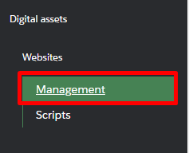
SCANING
Go to “Management” page
Click on “Add website”

Slide 9
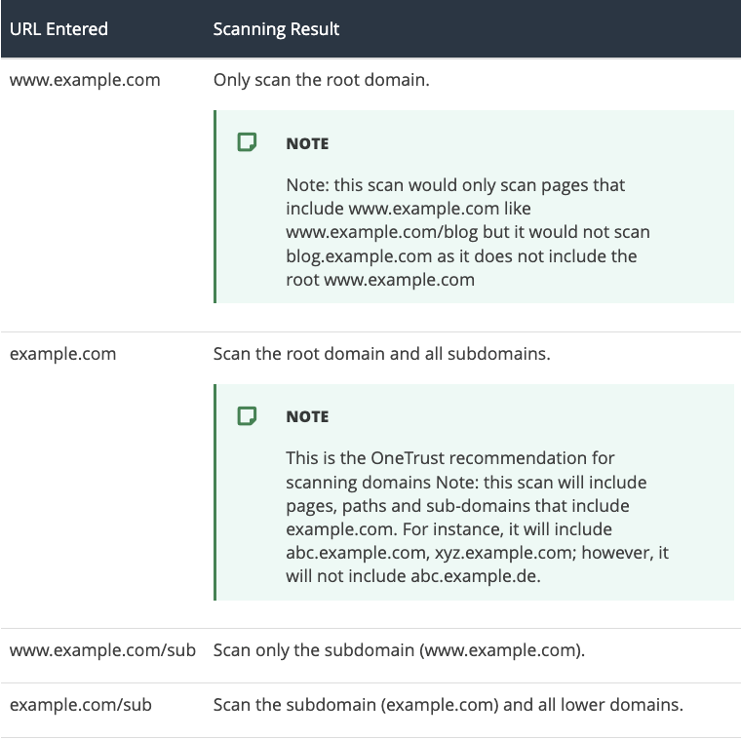
SCANING
Different writing of the domain can be use to limit the scan to a part of your domain, sub-domain or path.

Slide 10
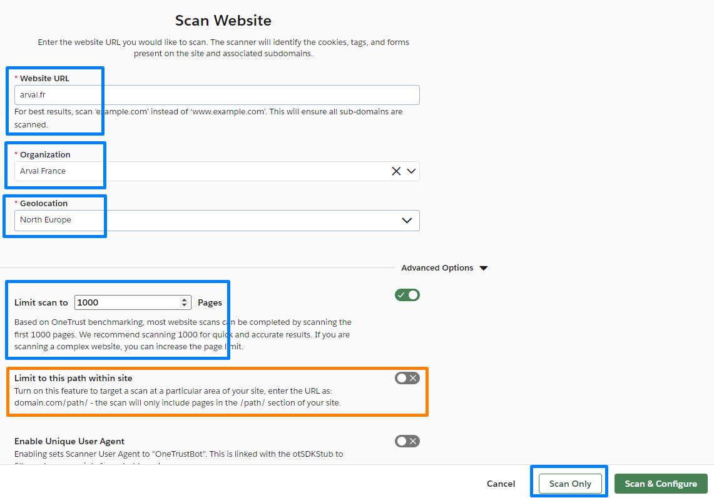
Website URL:
Put the URL of your website (Domain)
Example:
arval.fr
faq.arval.fr
If the domain have a repository make sure to enable the “Limit to this path within site” option
Example:
arval.fr/carrieres
arval.com/corp-test-dw
Organization:
Select the right organization
Geolocation:
Select the right geolocation
Limit scan to:
Recommended scan to ensure that all cookies are scanned
To finish click on “Scan only”
DOMAIN

Slide 11
SCANING STATUS
In “Management” page the “Status” of the scan if display:
Queued
Waiting for other scans to finish
Pending
Task ready to be launch
Scanning
In Progress
Completed
Scan completed
Failed Login
Credentials error in “Login” settings

Slide 12
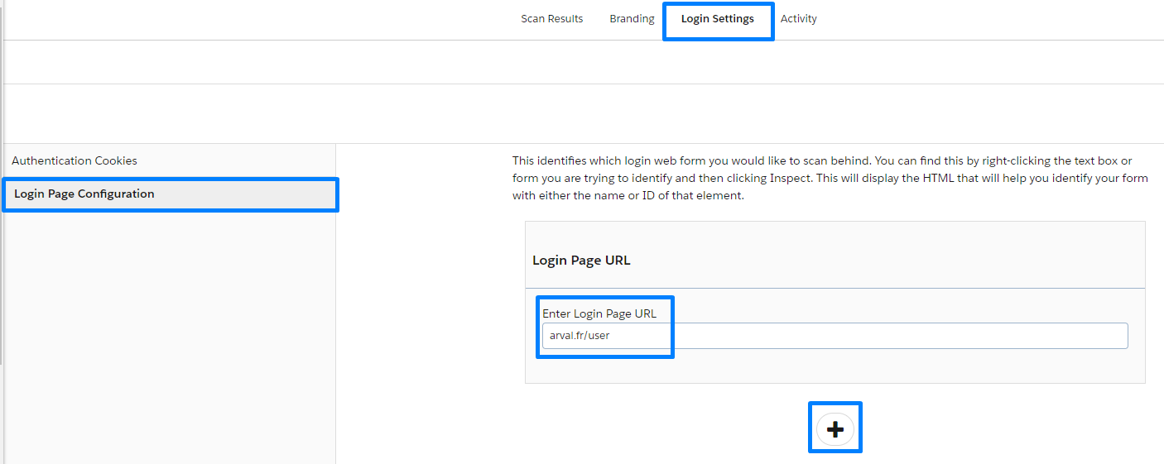
DOMAIN WITH LOGIN
If your website is protected by a “HTAccess” or “Login” page
you must put the credentials in scan settings
In “Management” page
click on the domain name
Note: This page display also all the statistics of the scanned website
Go on “Login Settings” > “Login Page Configuration”
Put the login URL
Click on “+”
Click “Add Webform”
Fill the Name & Password of the credentials
Don’t forget to “Save”

Slide 13
03.
COOKIES MANAGEMENT
How to manage “undefined” cookies?
Summary

Slide 14
“COOKIE” PAGE OVERVIEW
Cookie name
Name of the cookie
Source
From scan or manual creation
Lifespan
Duration of the cookie
Hostname
Host domain of the cookie
Default category
Category where OneTrust placed the cookie
Domain Category Overrides
Assigned category after manual modification
Domains
Number of domains assigned to the cookie

Slide 15
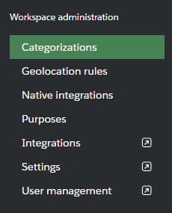
“UNKNOWN” COOKIE 1/2
In “Cookie” page:
Insert your domain in “All domains“ to filter

Slide 16
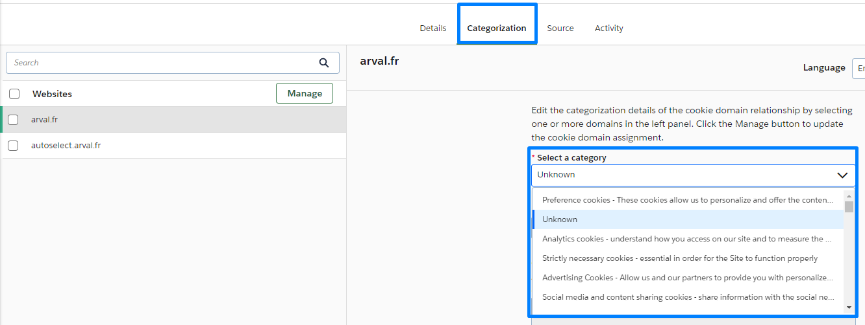
“UNKNOWN” COOKIE 2/2
Click on the cookie name you want to modify
Click on “Categorization” tab
Select the domain you want to modify
Select the category you want to assign to the cookie and Save

Slide 17
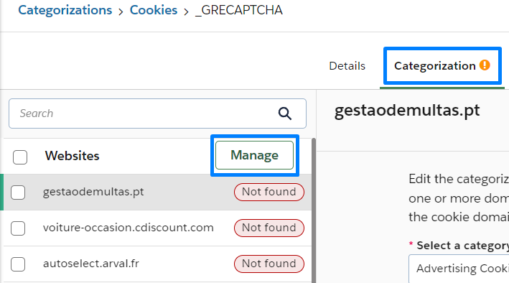
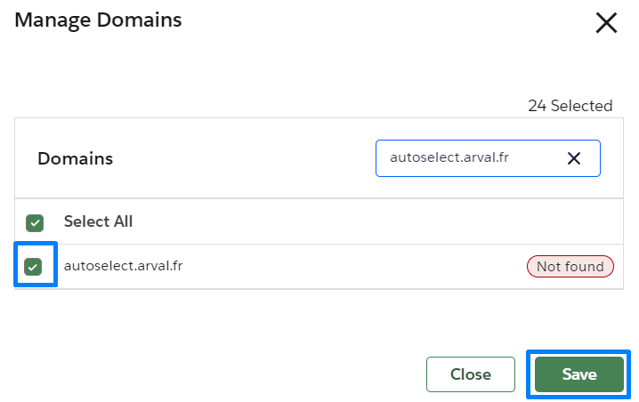
“MANUAL DELETION” COOKIE 1/1
Cookie must be remove manually
Once a re-scan is done on the website the cookie that don’t exist anymore are put in the “Not found” status
Click on the cookie name in the “Cookie” page
Click on “Categorization” tab
Click on “Manage”
Uncheck the domain
Click on “Save”

Slide 18
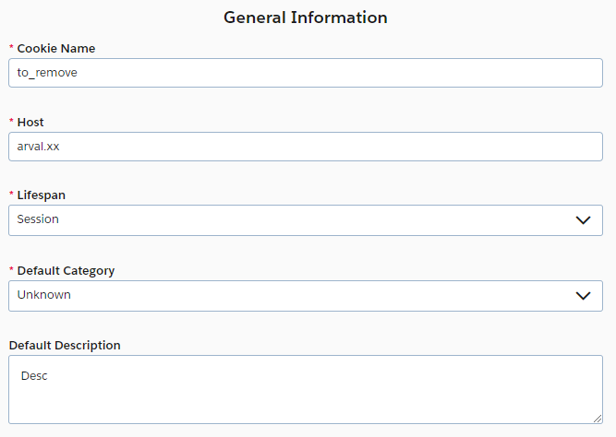
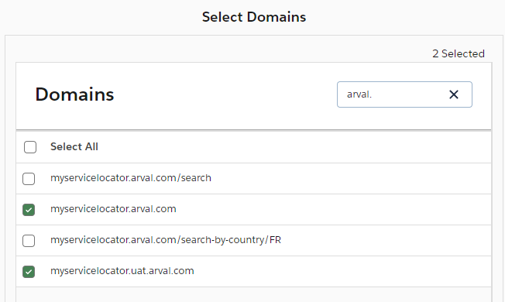
“MANUAL CREATION” COOKIE 1/2
Cookie can be add manually
In “Cookie” page click on « Add Cookie »
Fill the information
Then select the domain to associate to the cookie

Slide 19
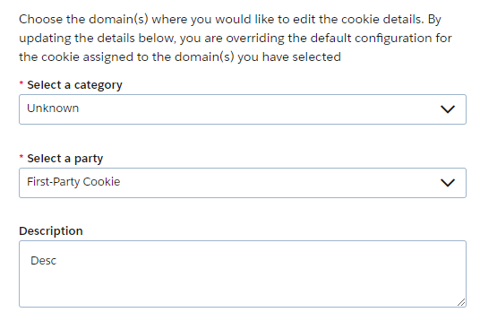
“MANUAL CREATION” COOKIE 2/2
Finally select the corresponding cookie category for the new one.

Slide 20
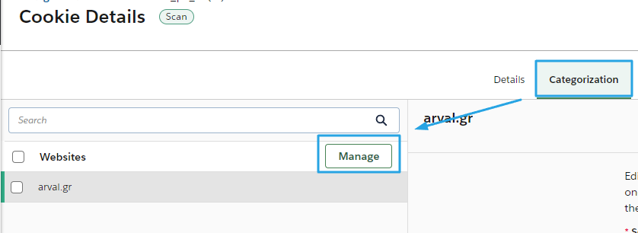
“PIWIK” COOKIE 1/1
If you are using Piwik a specific cookie must be associate to your website.
In “Cookie” page seach for « _pk_id.{id} » and click on one of the cookie name
Then click on « Categorization », « Manage », search and activate your domain then « Save »

Slide 21
04.
COOKIE BANNER
How to manage cookie banner?
Summary

Slide 22
“BANNER” PAGE OVERVIEW
Template Name
Name of the banner
Template Type
Type of template following GDPR
Current Version
Number of banner versions
Organization
Assigned organization
Created by
Banner creation
Default Template
Default created Geoloc rule by Corporate
Statut
Draft or Active
(Draft means that the geoloc rule is now used by a published script)

Slide 23
CREATE A BANNER 1/2
In “Cookie consent banner” page click on “Create new”
Select the “Frameworks And Laws”:
GDPR
LGPD for Brazil

Slide 24
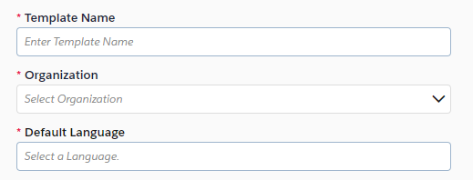
CREATE A BANNER 2/2
Template Name
Name of the banner
Organization
Banner’s organization
Make sure that Domain, Geoloc and banner are in the same organization
Default Language
Select the default language

Slide 25
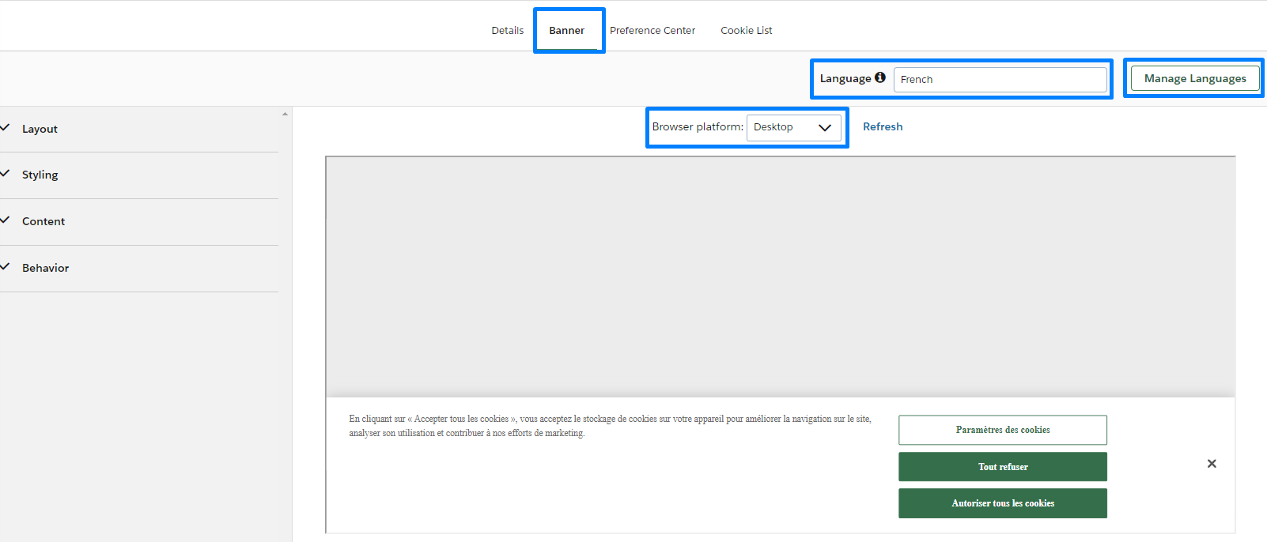
“BANNER” SETTINGS OVERVIEW 1/2
Banner
Cookie banner display on the first visit
Language
All parameters must be apply to all languages
Manage Languages
You can add multiple languages version
Advanced languages can be enable (pt-BR, ch-FR, …)
Browser platform
Preview of the banner

Slide 26
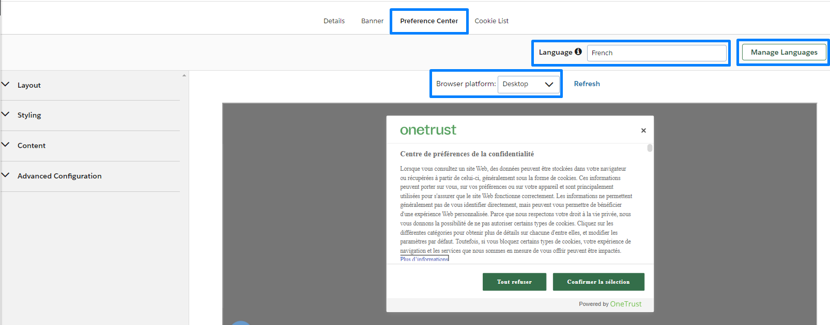
“BANNER” SETTINGS OVERVIEW 2/2
Preference Center
User cookie management display on the first visit
Language
All parameters must be apply to all languages
Manage Languages
You can add multiple languages version
Browser platform
Preview of the banner

Slide 27
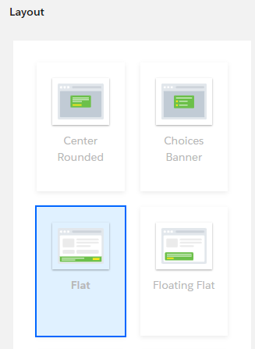
BANNER SETTINGS 1/3
(To apply to “Banner” & “Preference center”)
LAYOUT
Display style of the banner

Slide 28
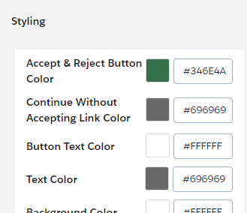
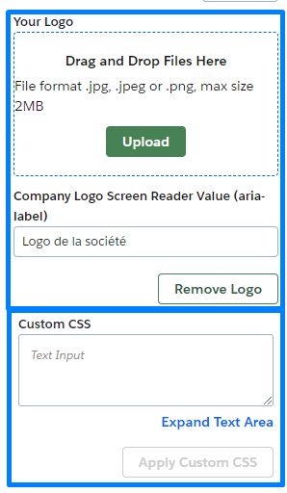
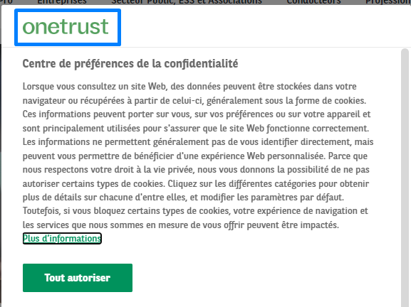
BANNER SETTINGS 2/3
(To apply to “Banner” & “Preference center”)
STYLING
Colors of the banner
Hexacode required
Personalized logo (In “Preference Center”)
Personalized CSS

Slide 29
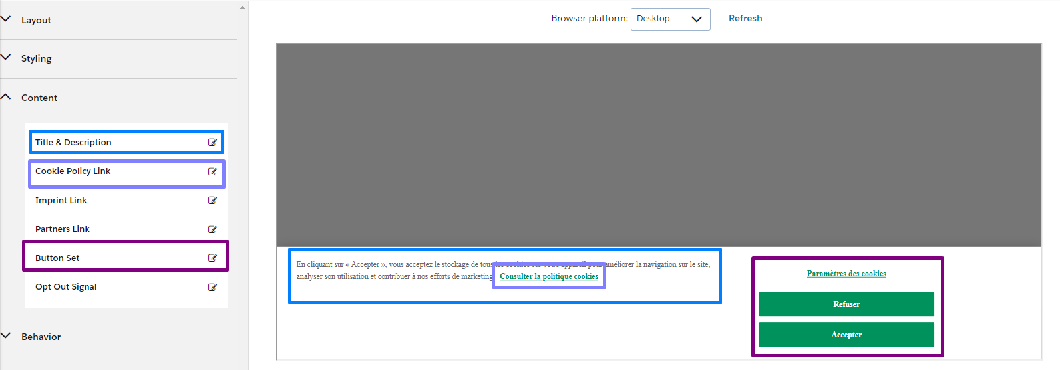
BANNER SETTINGS 3/3
(To apply to “Banner” & “Preference center”)
CONTENT
Banner description
Cookie policy link
Button settings

Slide 30
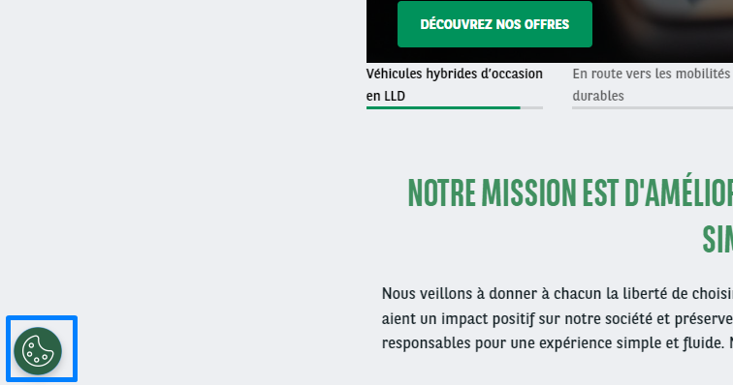
“PREFERENCE CENTER” BUTTON
Floating button
You can add a button on all pages of your websites allowing the user to modify the cookie choices (Preference Center)
This settings is in the “Preference Center” button option

Slide 31
05.
GEOLOCATION RULES
How to manage the Geoloc rule?
Summary

Slide 32
“GEOLOCATION RULE” PAGE OVERVIEW
Geolocation Rule Group
Name of the geoloc rule
Regions
Number of rules inside the Geoloc
Domains
Number of domains assigned to the Geoloc
Organization
Host domain of the cookie
Default Consent Model
By default
Default Rule Group
Default Geoloc rule by Corporate
Status
Draft or Active
(Draft means that the geoloc rule is now used by a published script)

Slide 33
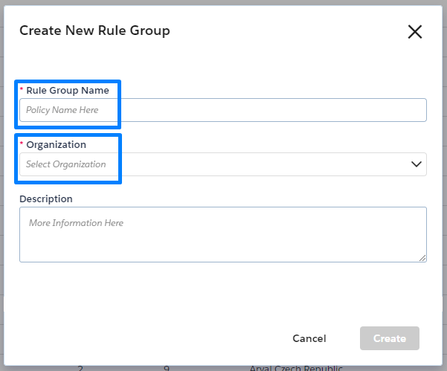
CREATE A GEOLOCATION RULE 1/3
In “Geolocation Rules” page click on “Create new”
Rule Group Name
Name of your Geoloc rule
Organization
Select the organization to assign
Description
Optional description

Slide 34
CREATE A GEOLOCATION RULE 2/3
Click on “Edit” pencil
Rule Name
Name of your Geoloc rule
Template
Select the banner to assign
Make sure to enable the “Capture Records of Consent” and “Save”

Slide 35
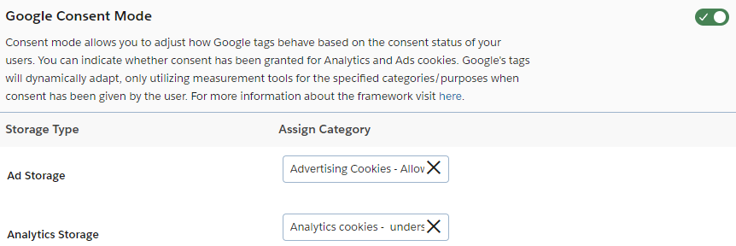
FOR “GOOGLE ADS” USER ONLY
Activate “Google Consent Mode”
Follow the assignment below for the “Storage Type”

Slide 36
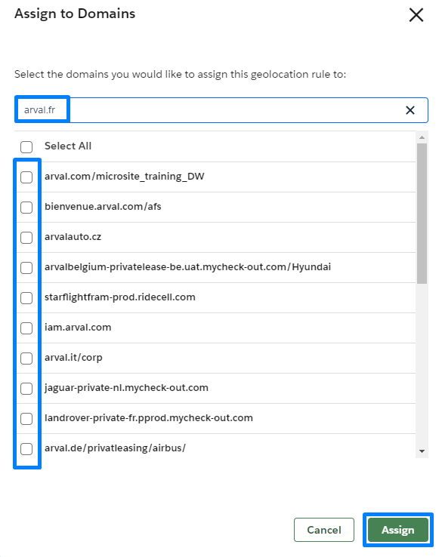
CREATE A GEOLOCATION RULE 3/3
Then click on “Assigned Domains” tab and “Assign to Domains”
Search and check your domain then click “Assign”

Slide 37
06.
SCRIPTS
How to manage the script?
Summary

Slide 38
“SCRIPT” PAGE OVERVIEW
Name
Domain script
Geolocation Rule
Assigned Geolocation rule
Last Test Date
Last date of “Test” script publication
Published date
Last date of “Production” script publication
Published by
Last publisher
Published Version
OneTrust version of the script
(Make sure to update regularly)
Status
Draft or Published
(Draft means that the script is not published)

Slide 39
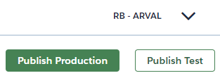
“SCRIPT” PUBLISHING 1/3
In “Script” page click on the domain you want to publish
Click on “Publish Test” to publish the test preview
Click on “Publish Production” to publish the prod preview

Slide 40
“SCRIPT” PUBLISHING 2/3
Select the One Trust version for the script and click on “Next”
(We suggest the latest version)
If you are using Google Analitycs we suggest to disable this option

Slide 41
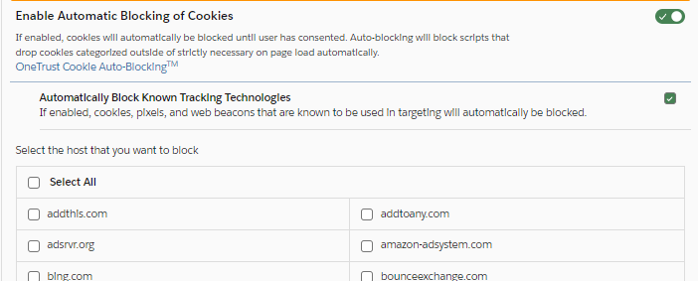
“SCRIPT” PUBLISHING 3/3
This option determine the banner language depending on two possibility:
User browser language
HTML page language
We suggest to disable this option
(If use, GTM parameters will need to be update)
Click on “Publish”

Slide 42
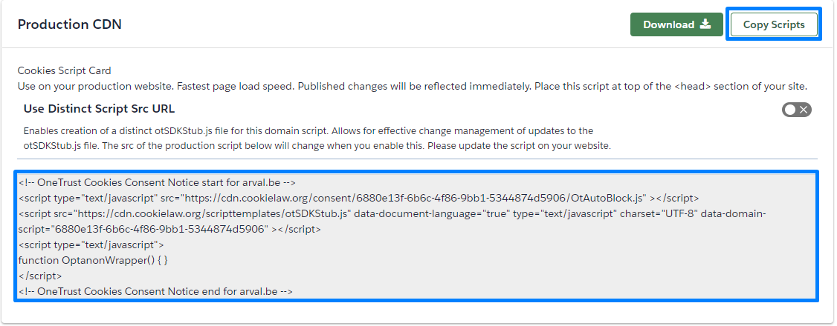
“SCRIPT” SYNCHRONIZATION 1/2
In “Script” page click on “Production Scripts”
The main script is used to synchronize One Trust to your website
If the website if part of the Arval Website Factory:
Create a Jira to request the script integration in Drupal
If the website if outside of the Arval Website Factory:
The script is to be integrated in the Header of your website code

Slide 43
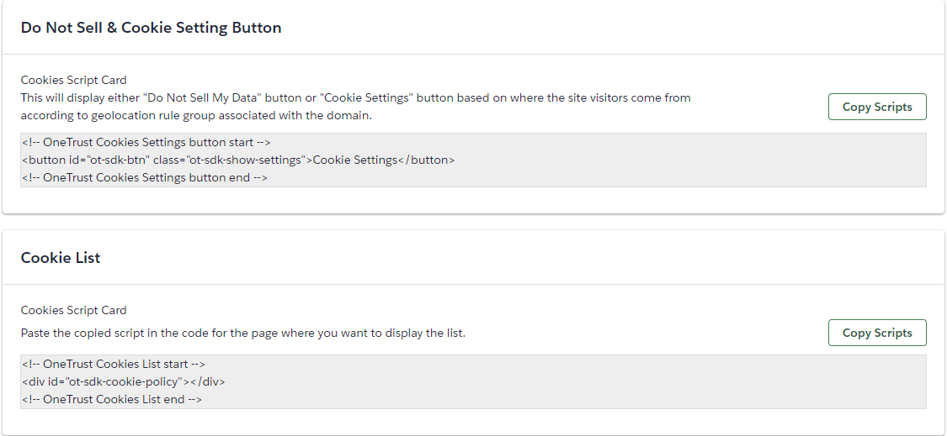
“SCRIPT” SYNCHRONIZATION 1/2
This script to put in your HTML page is displaying the “Preference Center” button
This script to put in your HTML page is displaying an automatic “Cookie list” table based on OneTrust results

Slide 44
Company information:
Datawords France 66 rue de Villiers,
92300 Levallois-Perret, FRANCE
T. +33 1 75 33 80 80
F. +33 1 75 33 80 81

