Slide 1
DRUPAL 8 LAYERS CATALOG
Notes:
Comment insérer une image d’arrière-plan ?
Allez dans « affichage » > Masque des diapositives
Choisissez la slide de couverture
Effacez l’arrière-plan
Insérez votre image
Cliquez sur « Mettre en arrière-plan »
Fermez le masque des diapositives, c’est fait !

Slide 2
SUMMARY
« Page Apollo » contents
« Page » contents
All contents

Slide 3
Page Apollo contents (Only available on « Page Apollo » contents) https://www.arval.com/corp-test-dw/corporate/paragraph-demo-pge-apollo
Brand list/Brand teaser
Corporate Service Additional
Herozone - slider
Navigation Picture Banner
Text + link

Slide 4
Brand teaser / Brand list
Visual size: 100x100px
Summary

Slide 5
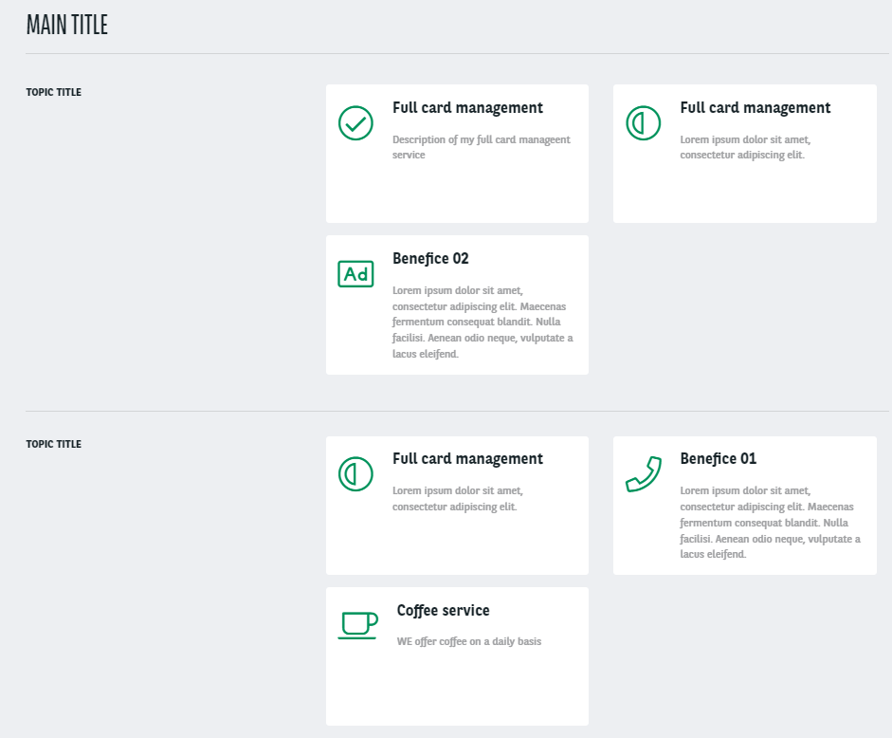
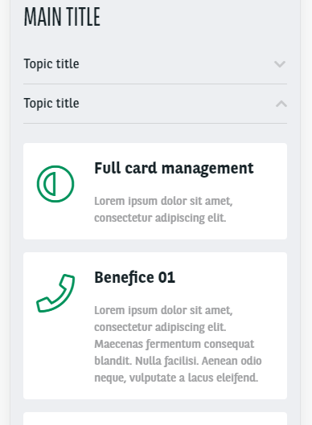
Corporate Service Additional
Summary

Slide 6
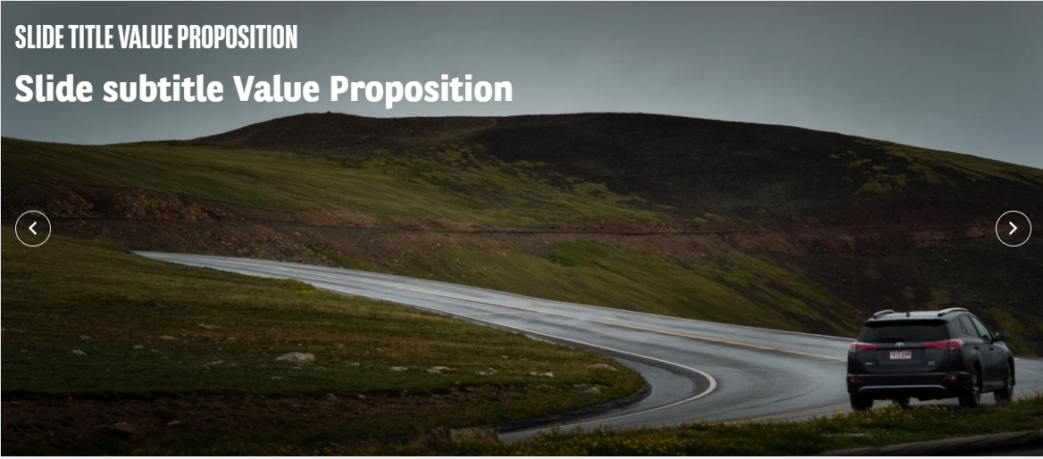
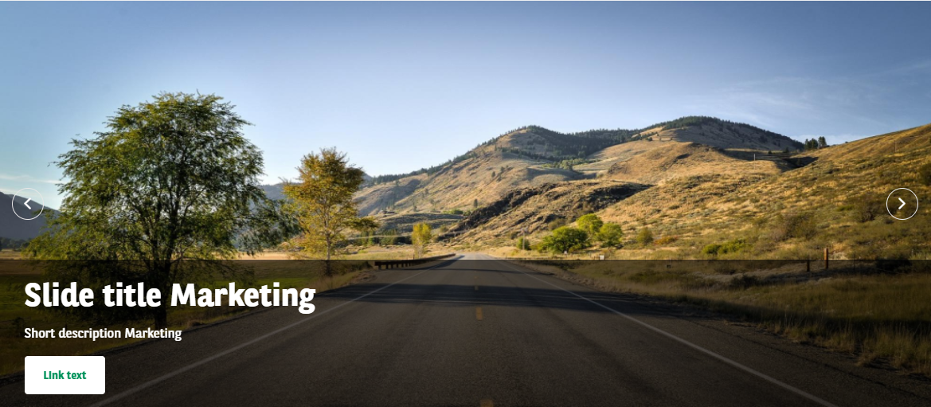
Hero slider
Summary
Hero Slider has 2 different items:
Value proposition
Marketing

Slide 7
Navigation Picture Banner
Visual size: 240x160px
Summary

Slide 8
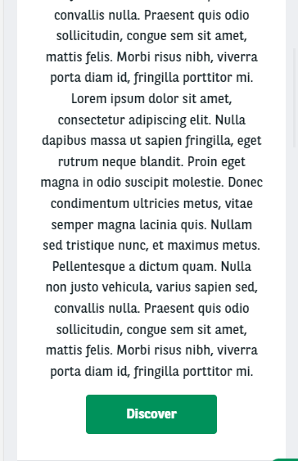
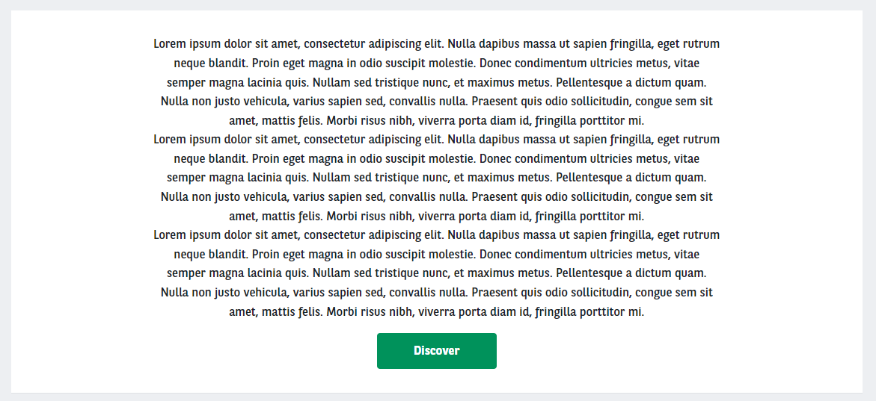
Text + link
Summary

Slide 9
Page contents (Only available on « Page » contents) https://www.arval.com/corp-test-dw/corporate/paragraph-demo-page-contents
1 to 4 foldable arguments
2 foldable arguments
3 columns carousel
4 picto/car arguments
Customer account
Full picture
Gallery
Iconic list
Image
News Banner
Slider
Testimonials
Title + Links
Title + Text
Video carousel

Slide 10
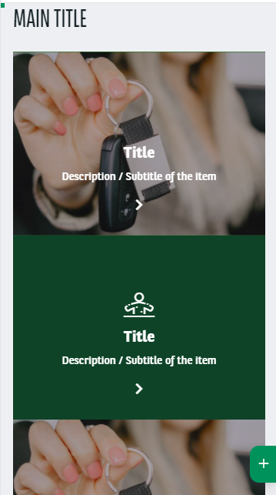
1 to 4 foldable arguments
(Must be use with 4 arguments for better display)
Summary

Slide 11
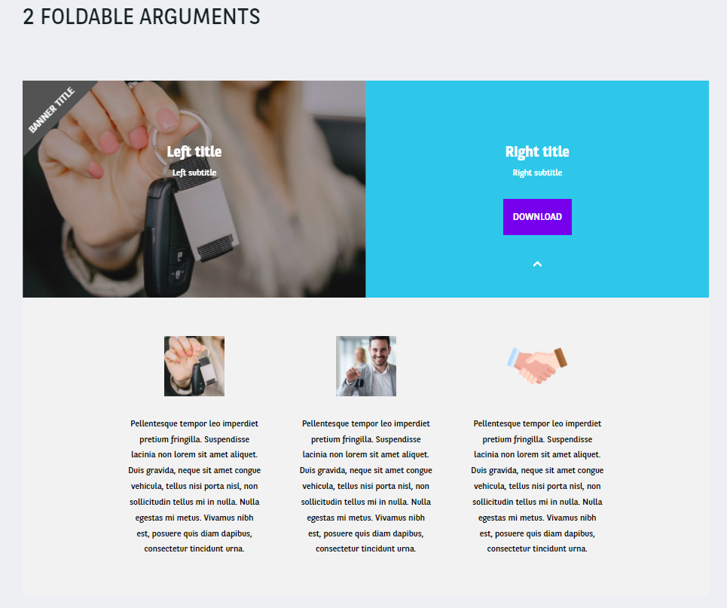
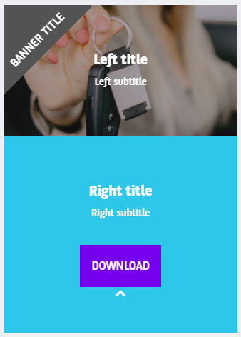
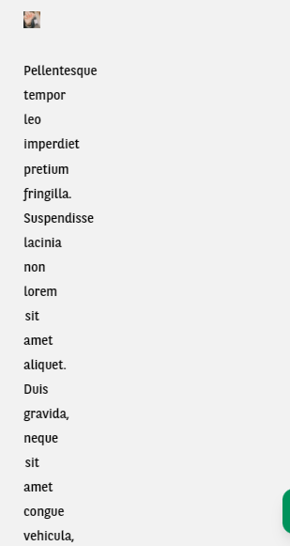
2 foldable arguments
Mobile version not adapted for the sub arguments
Summary

Slide 12
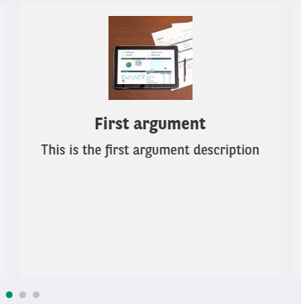
3 columns carousel
Visual size: 100x00px
Summary

Slide 13
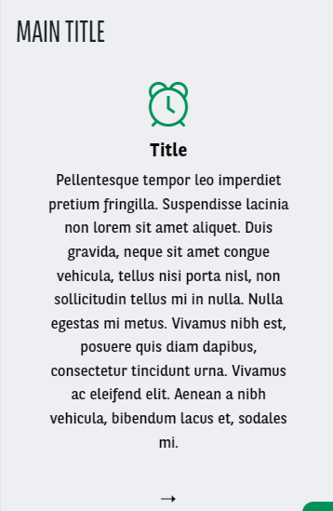
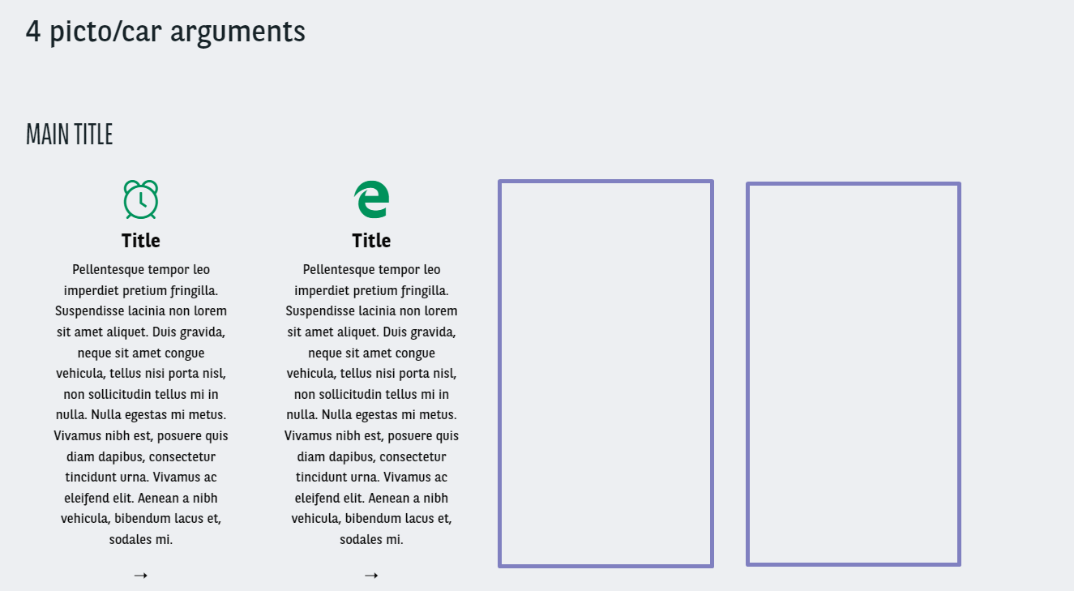
4 picto/car arguments
Summary

Slide 14
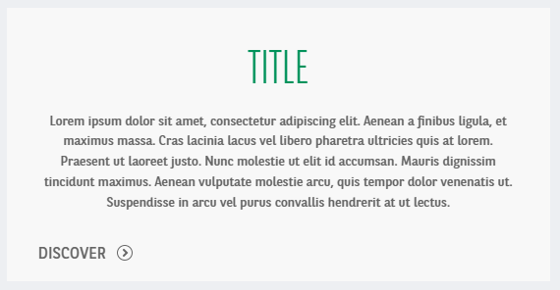
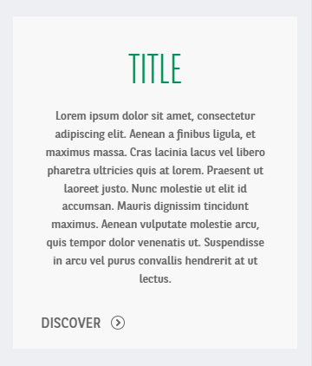
Customer account
Summary

Slide 15
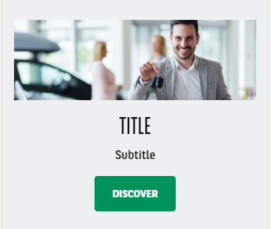
Full picture
Summary

Slide 16
Gallery
Summary

Slide 17
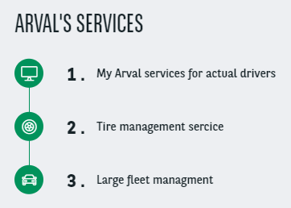
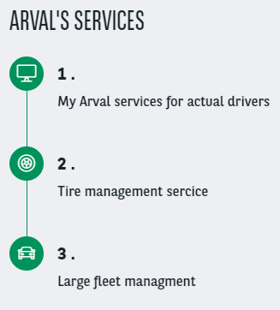
Iconic list
Summary

Slide 18
Image
Summary

Slide 19
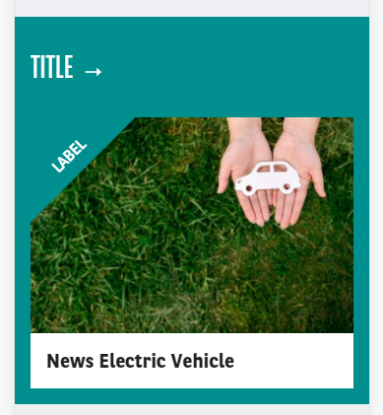
News banner
Summary

Slide 20
Slider
Summary

Slide 21
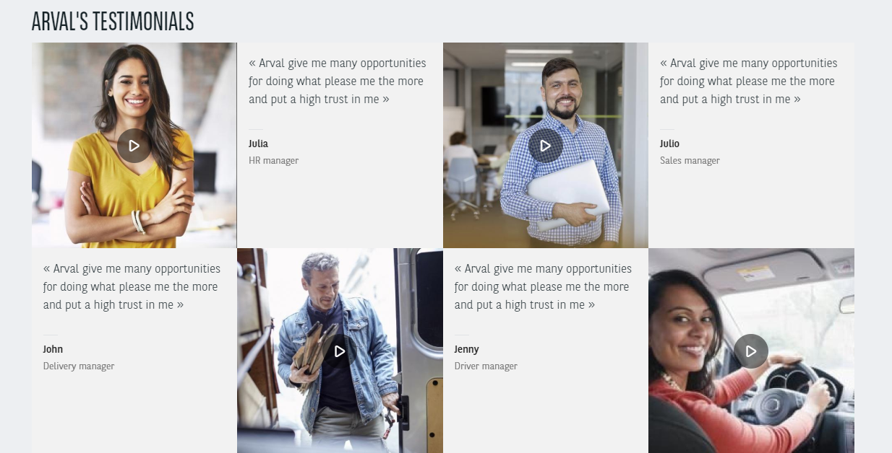
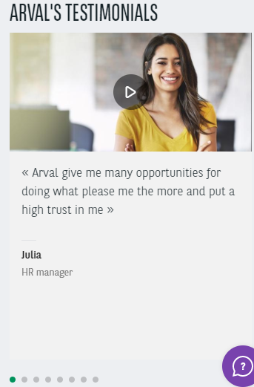
Testimonials
Visual size: 250x350px
Summary

Slide 22
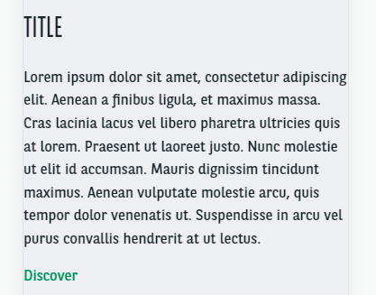
Title + links
Summary

Slide 23
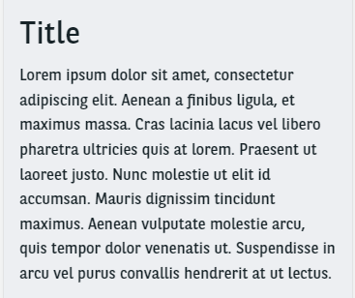
Title + Text
Summary

Slide 24
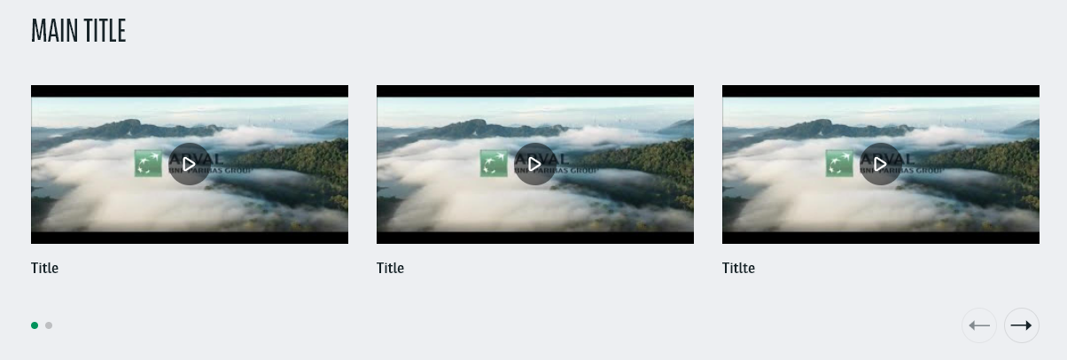
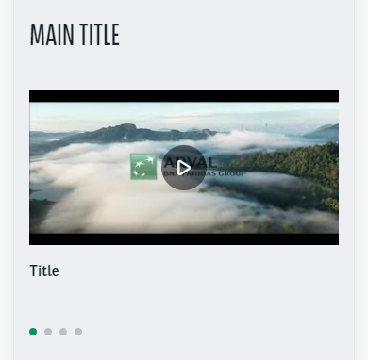
Video carousel
Summary

Slide 25
aLL CONTENTS (« Page » & « Page Apollo » contents) https://www.arval.com/corp-test-dw/corporate/paragraph-demo-all-contents-12 https://www.arval.com/corp-test-dw/corporate/paragraph-demo-all-contents-22
2 columns
2 to 4 long arguments
4 items banner
5 visual entries
Apollo Sticky Anchors
Career - All offers
Career - Highlighted job offers
Career - Job offer map
Career - Job offer search
Career - Recruitment process
Career - Team categories
Contact modal form
Corporate service Included
Download document
Edito landing page
FAQ
Header image
HTML
Marketing Block
Mosaic 1/2 argument
Navigation color banner
News - search/list
News Highlight
News highlight banner
Newsroom - Quote Banner
One tab visual
Persona
Services proposition
Slider Testimonial
Solutions
Text + Image + CTA
Two tabs visual
Value Proposition
Visual Type
Webform

Slide 26
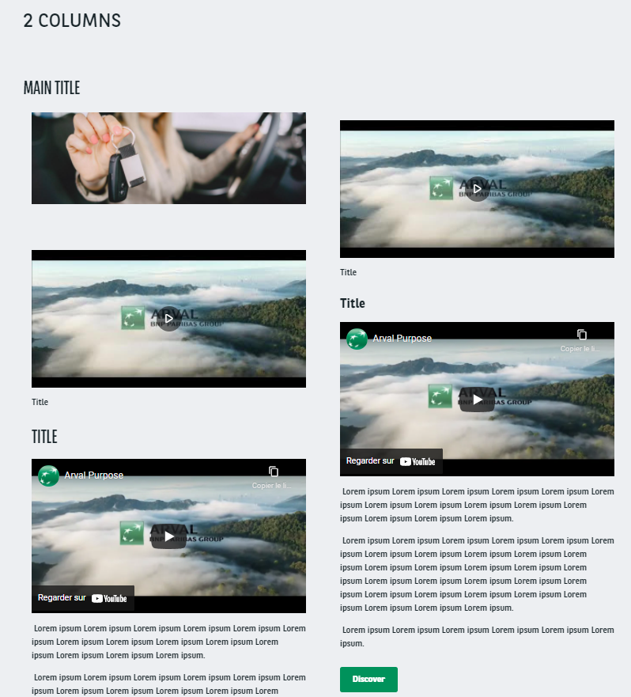
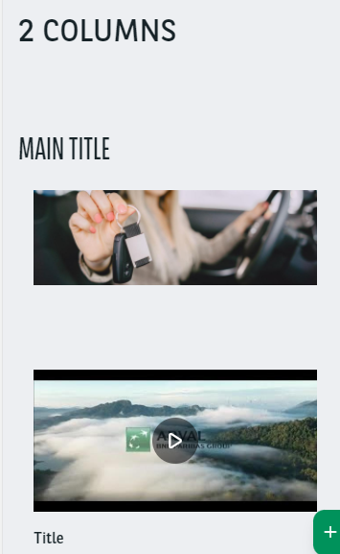
2 columns
Become one column on mobile view
Summary

Slide 27
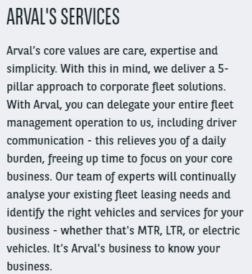
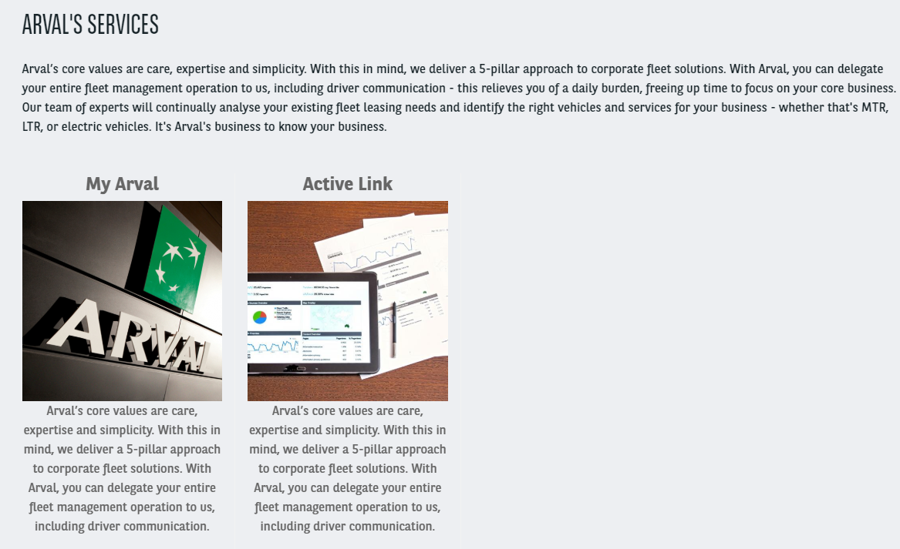
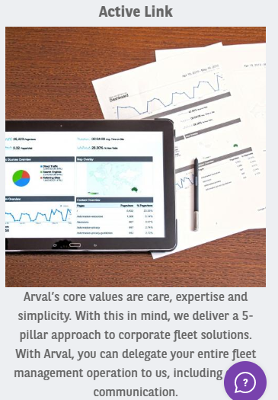
2 to 4 long arguments
Visual size: 500x500px
Summary

Slide 28
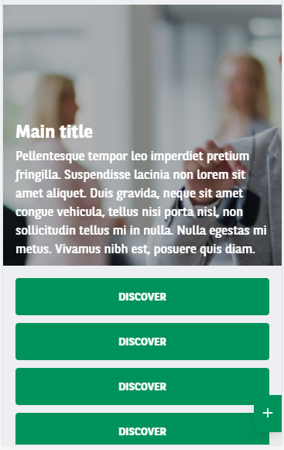
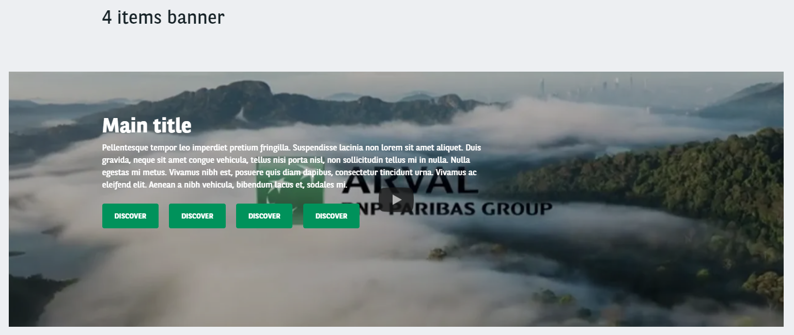
4 items banner
Description = 250 caracters max.
Summary

Slide 29
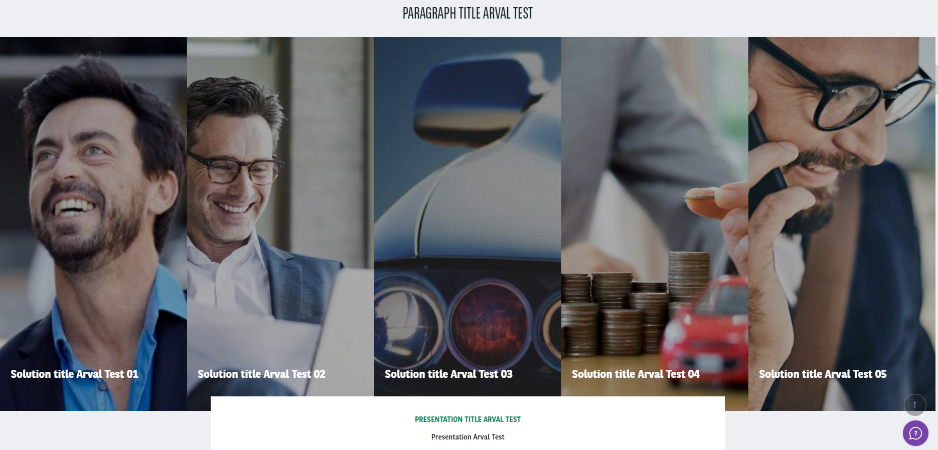
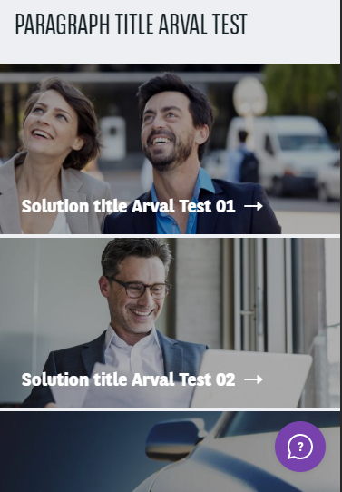
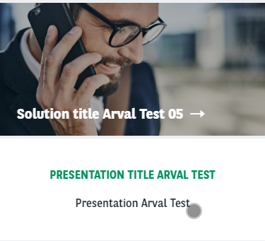
5 visual entries
Visual size: 640x320px
Summary

Slide 30
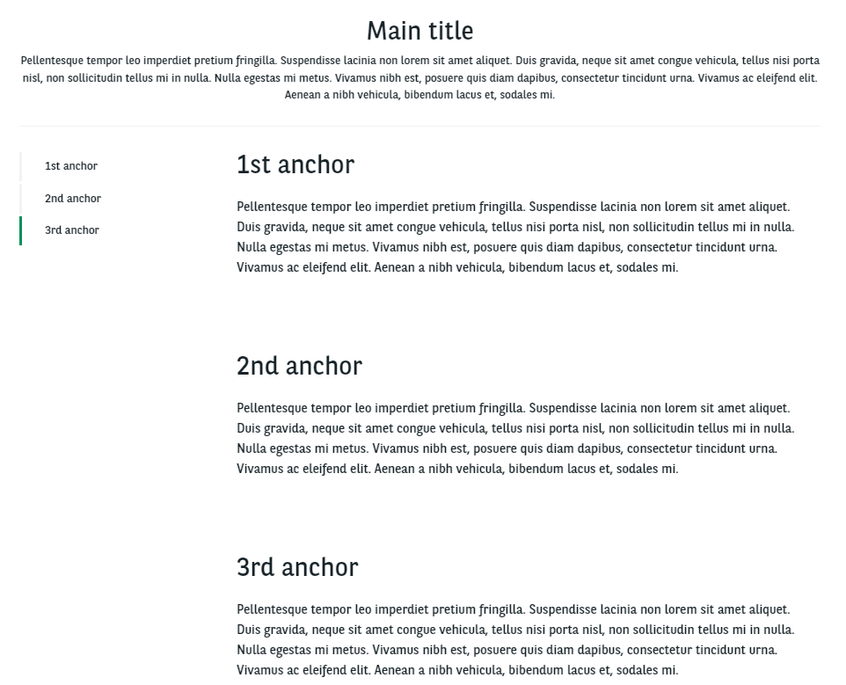
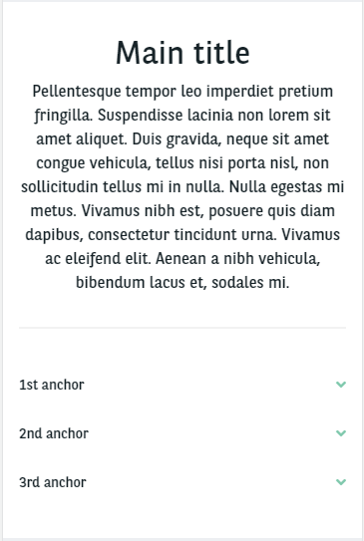
Apollo Sticky Anchors
Summary

Slide 31
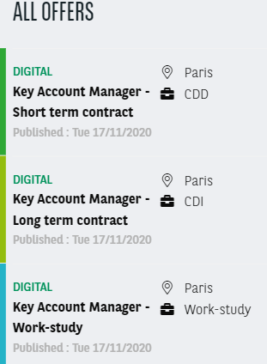
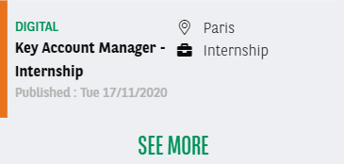
Career - All offers
Summary

Slide 32
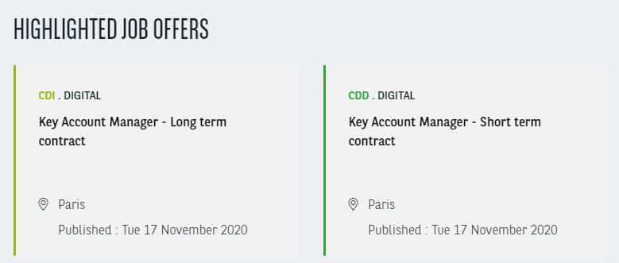
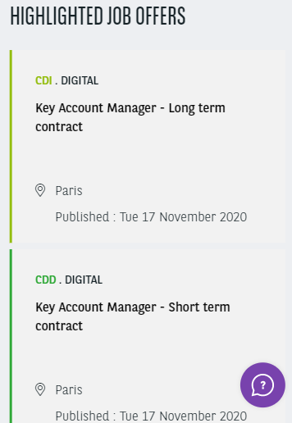
Career - Highlighted job offers
Summary

Slide 33
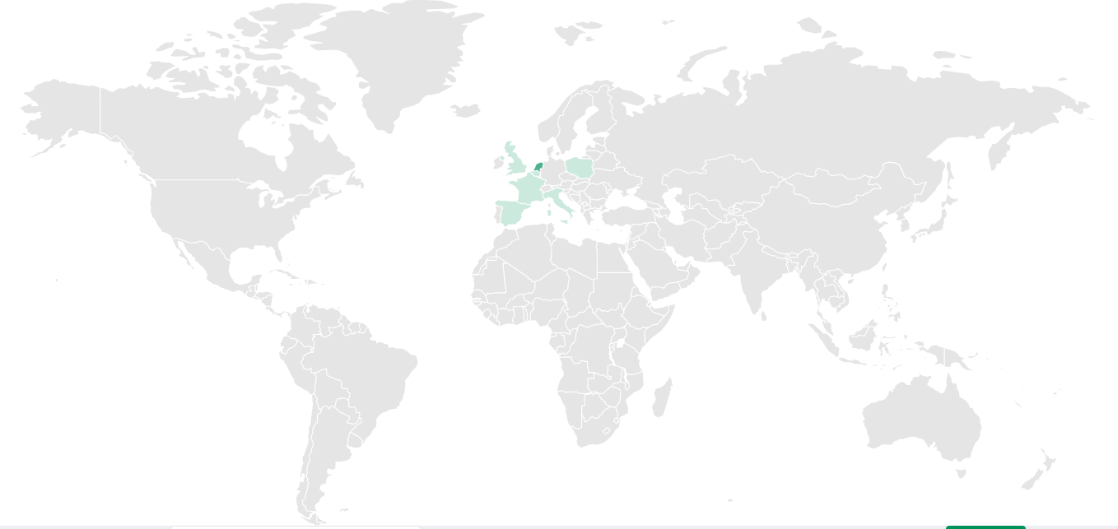
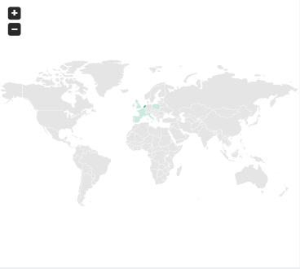
Career - Job offer map
Summary

Slide 34
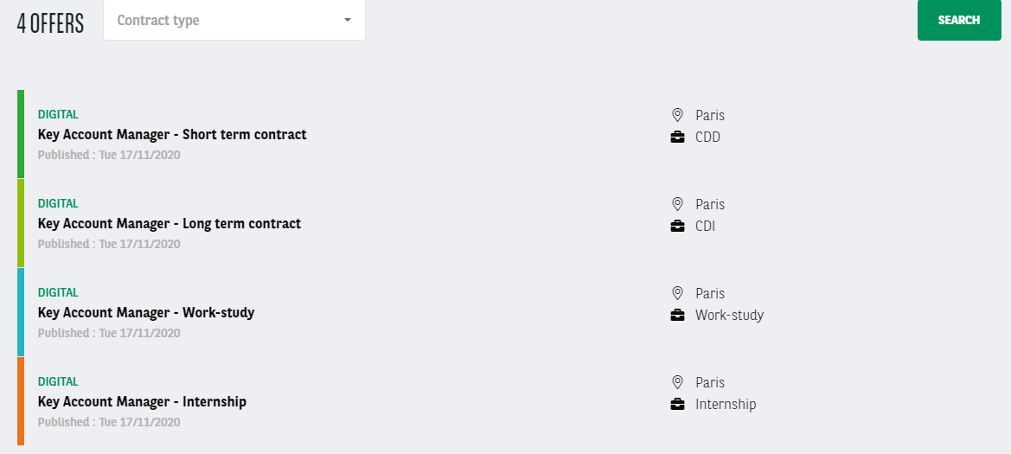
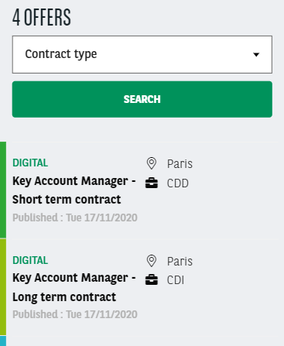
Career - Job offer search/list
Summary

Slide 35
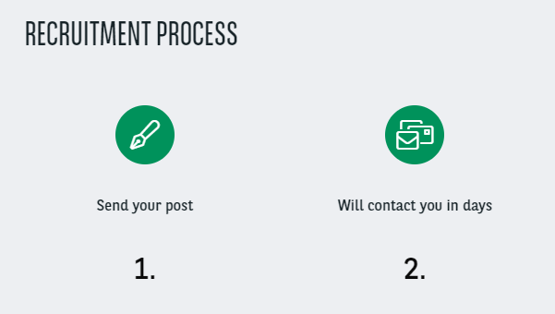
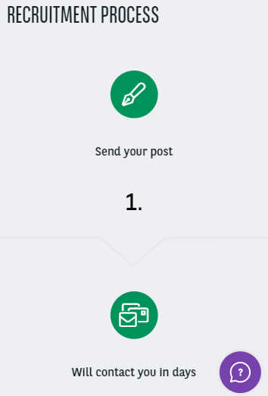
Career - Recruitment process
Summary

Slide 36
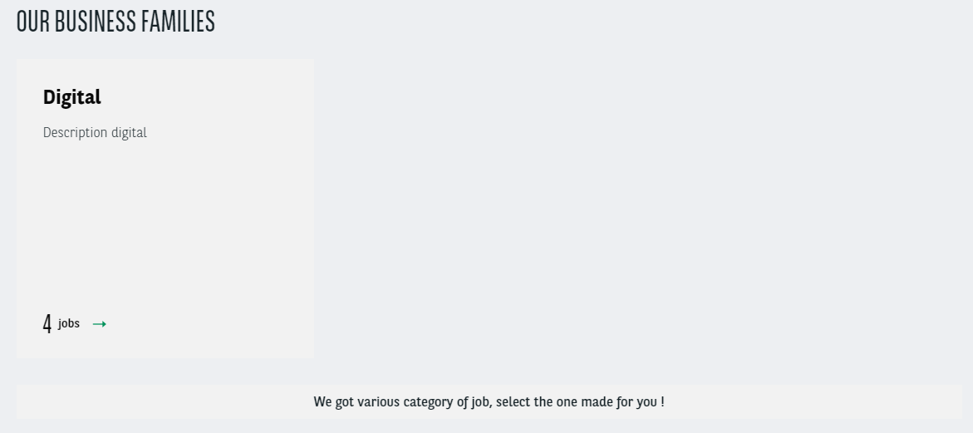
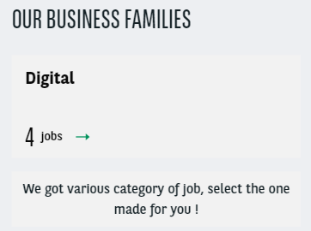
Career - Team categories
Summary

Slide 37
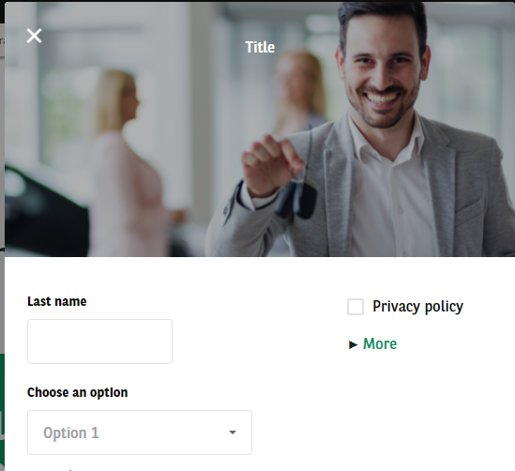
Contact Modal Form
Summary

Slide 38
Corporate service included
Summary

Slide 39
Download document
Visual size: 640x320px
Summary

Slide 40
Edito landing page
Summary

Slide 41
FAQ
Summary

Slide 42
Header image 1/2
Visual size: 1900x400px
Summary

Slide 43
Header image 2/2
Summary

Slide 44
HTML
Summary

Slide 45
Marketing block
Visual size: 600x255px
Summary

Slide 46
Mosaïc ½ argument
Summary

Slide 47
Navigation color banner
Summary

Slide 48
News - search/list
Summary

Slide 49
News Highlight
Summary

Slide 50
News highlight banner
Summary

Slide 51
Newsroom Quote banner
Visual size:
Background: 1900x600px
People: 170x170px
Summary

Slide 52
One Tab Visual
Visual size: 1500x650px
Summary

Slide 53
Persona
Visual size: 400x260px
Summary

Slide 54
Service proposition
Visual size: 900x600px
Summary

Slide 55
Slider Testimonial
Visual size: 650x380px
Summary

Slide 56
Solutions
Visual size: 1500x500px
Summary

Slide 57
Text + Image + CTA
Visual size: 814x542px
Summary

Slide 58
Two tab visual
Visual size: 1500x300px
Summary

Slide 59
Value Proposition
Visual size: 480x270px
Summary

Slide 60
Visual Type
Summary

Slide 61
Webform 1/3
Summary

Slide 62
Webform 2/3
Summary
THEMES
Regular
Grey
Grey with theme color lines
Theme color background

Slide 63
Webform 2/3
Summary
ALIGNEMENTS
Left
Center
Right
Justify

