Slide 1
JIRA TRAINING FOR APOLLO
Digital acquisition team
March 2020

Slide 2
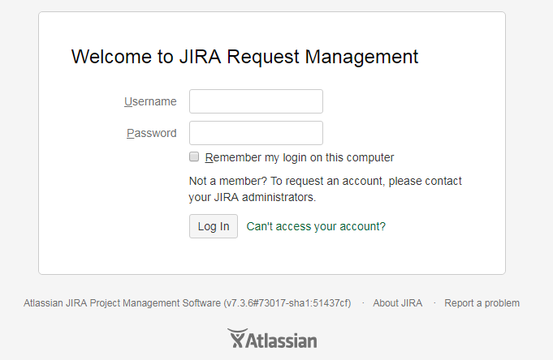
1) How to login
https://reman.arval.com/login.jsp
Normally, your JIRA access have been already created by us.
Your Jira IDs are the same than you sessions Ids (UID and computer password).
If you don’t have access to it, please contact:
Jira.support@arval.fr
UID
Session password

Slide 3
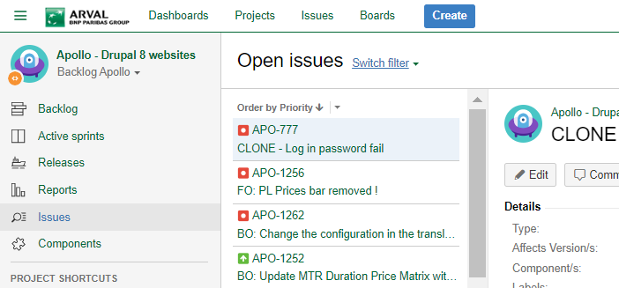
2) STEPS TO create a JIRA

Slide 4
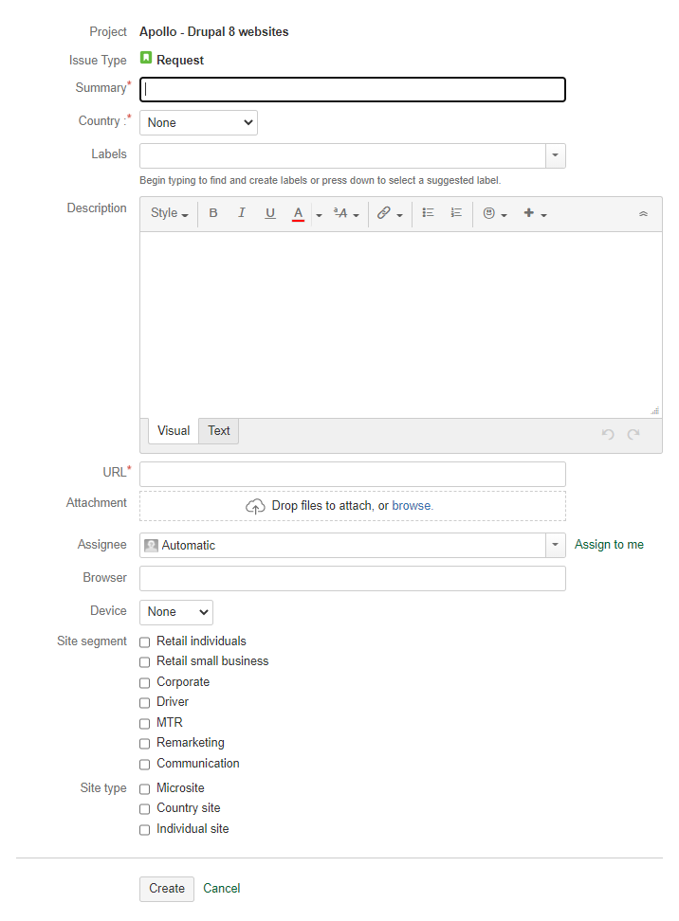
Select the good project – Apollo - Drupal 8 websites (APO)
Select “Request” issue type
Explicit title
Select your country
Mandatory
Labels = blueline + your_country_code
Precise in the description of your ticket:
The role impacted by the bug: User/Webmaster/Admin
Device / Browser / Version
URL
Current behaviour
Expected behaviour
Screenshot
If no specific URL put your website URL
Download picture displaying the problem, if nothing in Description
Let « Automatic » assignee
On which browser the issue was face
On which Device the issue was face: Desktop or Mobile
On which segment of your website the issue appear
Select the type of your website
Then Create your JIRA !

Slide 5
IMPORTANT !
To avoid timeconsuming back & forth, please fill from beginning
mandatory fields and make sure your description have all requested items !
And do not forget URL and screenshot, fundamental for your interlocutor
understands your problem !
Mandatory fields
Screenshot
URL

Slide 6
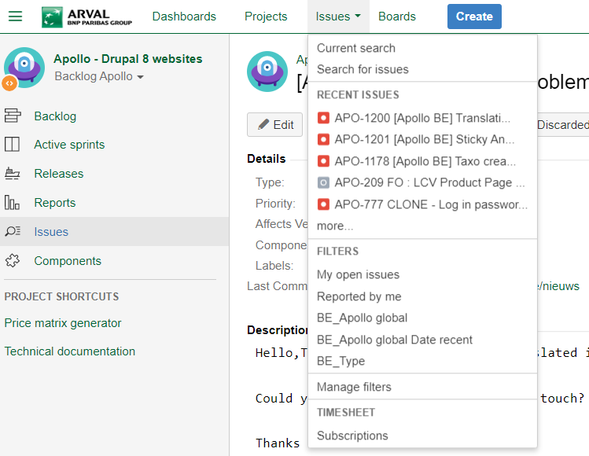
3) Follow your demands
All the Jira you’ve created are available on the filter « My open issues »

Slide 7
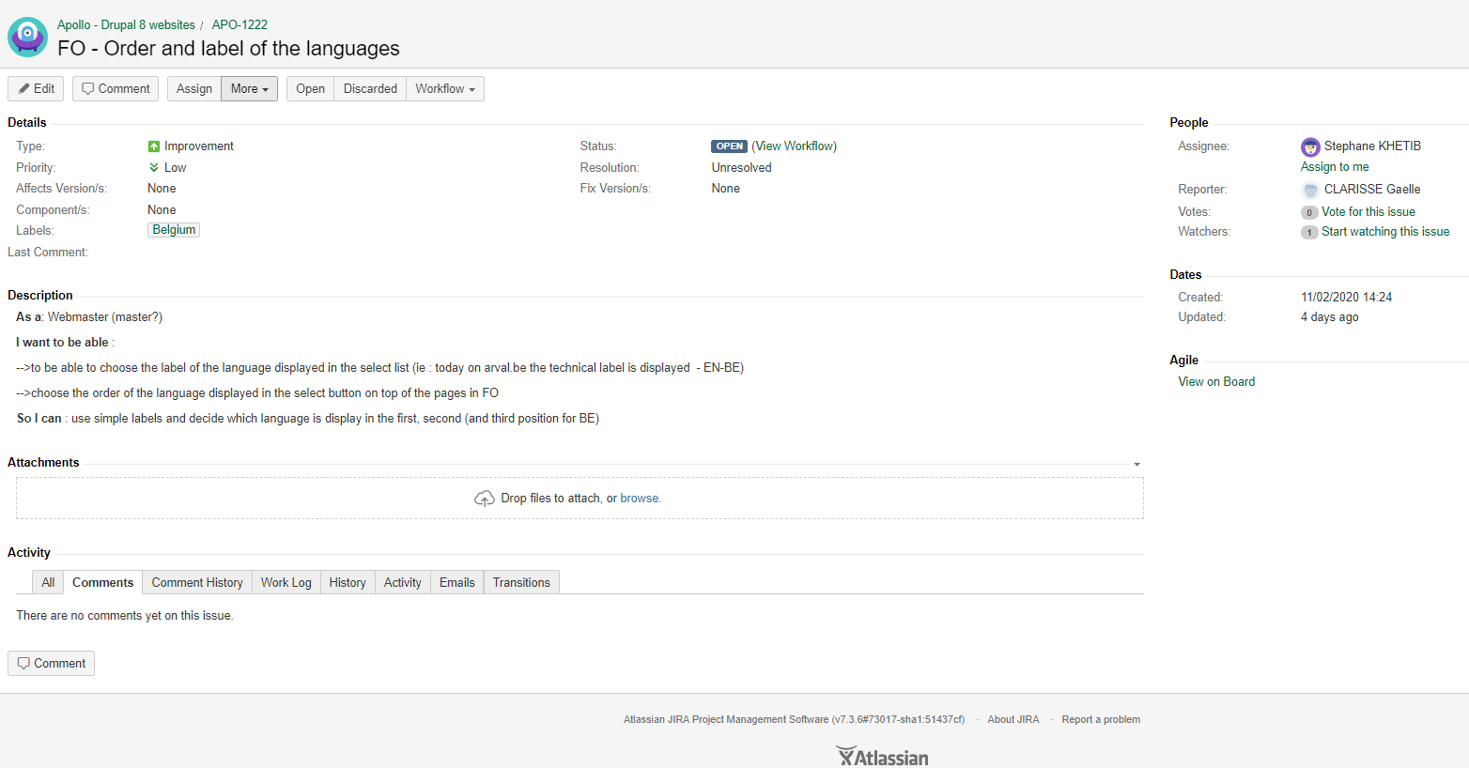
4) Manage a created demand
You can change the status of the Jira following the workflow (see the end of this document).
Change the status if all is OK from your side only, because we can not go back.
Possibility to change assignee
Here is the sum up of your demand.
Here is the Wall where you can leave comment, the agency will also write here

Slide 8
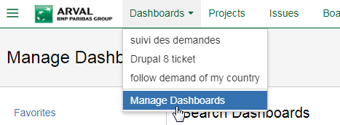
5) Manage your dashboard
Creating dashboards with JIRA is very dynamic, simple and efficient !
You have the possibility to create a dashboard which will help you to get an overview of all demands of your country.
Click on manage dashboards
1
2

Slide 9
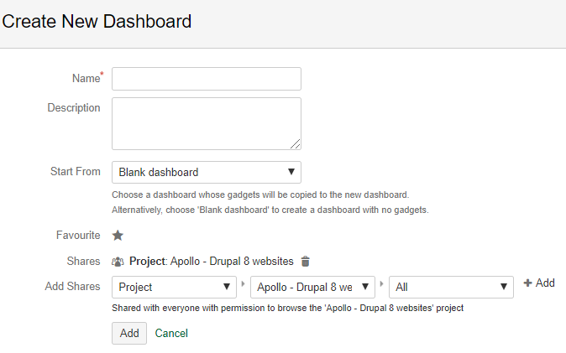
3
Name your dashboard
Once you add “Project / Apollo Drupal 8” in order to share with members of the team, please do not forget to click on ADD
4
Add gadgets to your dashboard and set it as you want.

Slide 10
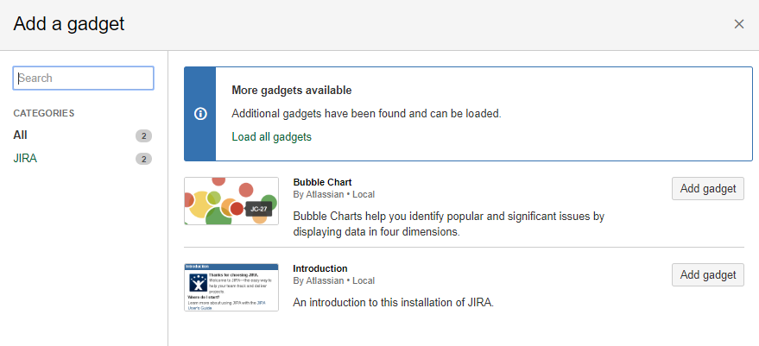
5
Load all gadgets to have all ones available
6
Once your dashboard is done, you can find it again here

Slide 11
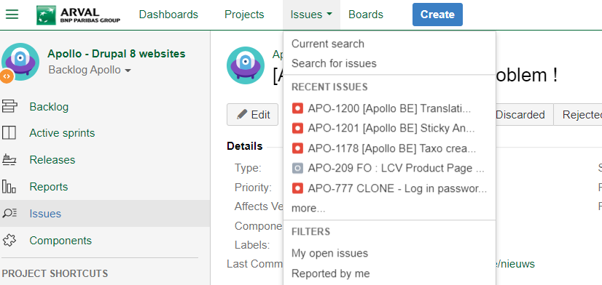
6) Create a Filter – choose to see only demand of your country
Go on the current search of your project
1

Slide 12
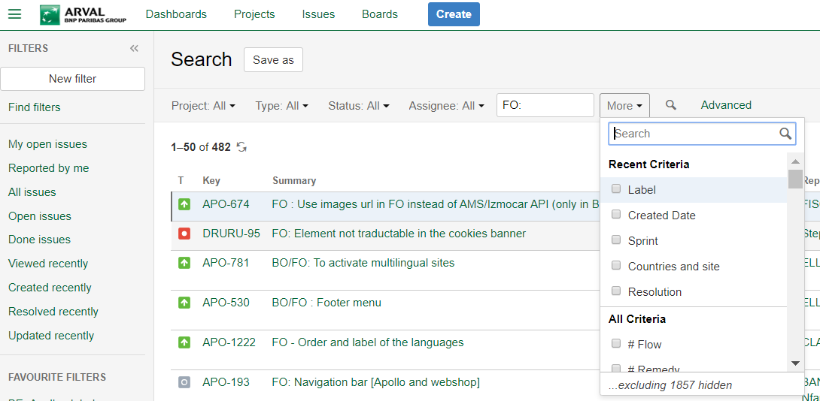
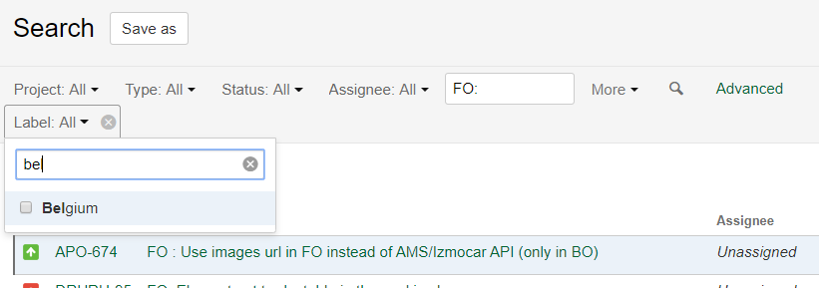
2
Search on “more” the field LABEL
3
Select you website and your specific site (if it’s necessary).

Slide 13
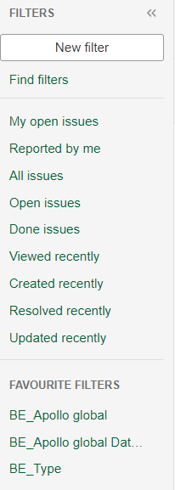
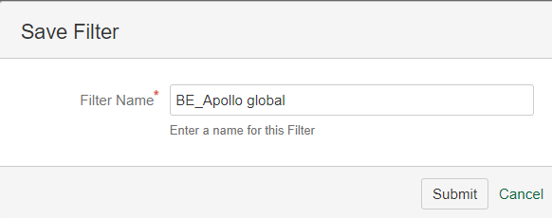
4
6
5
Find your filters on the left.

Slide 14
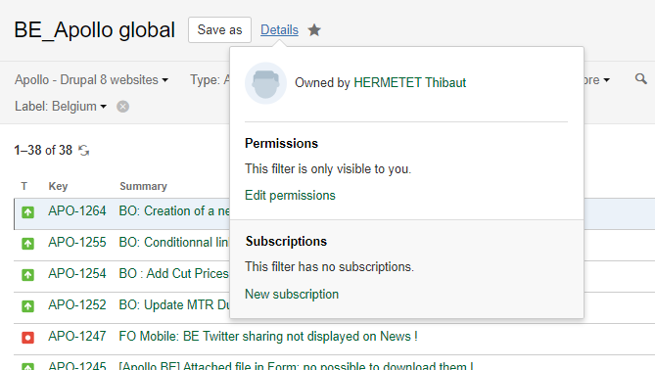
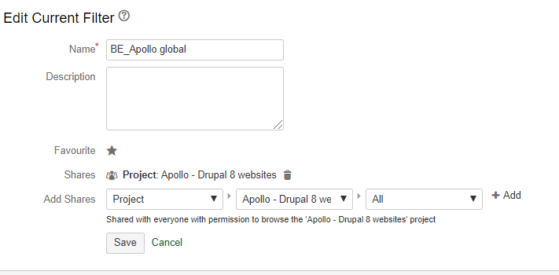
7
Edit permissions, or else your filter will be visible just to you
8
Then select Project > Apollo Drupal 8 > ADD

Slide 15
Process After the country training (until 3 month after the public launch)
Arval countries
Dataword referent
Arval Apollo Team
Ekino
Create “Request”
Jira ticket
Analyse
If webmastering
If bug
Change the ticket type to “Webmastering”
Change the ticket type after qualification
Analyse
Receive the notification
Answer in Jira
If webmastering
If bug
Receive the notification
Change the statut to “Request”
Assign
Correct
Close the ticket
Test
Deliver
Receive the notification
Receive the notification
Release
Jira notification

Slide 16
Annex: PRIORITY LEVELS

