Slide 1

HOW TO
PHONE ACCESSIBILITY
Summary

Slide 2
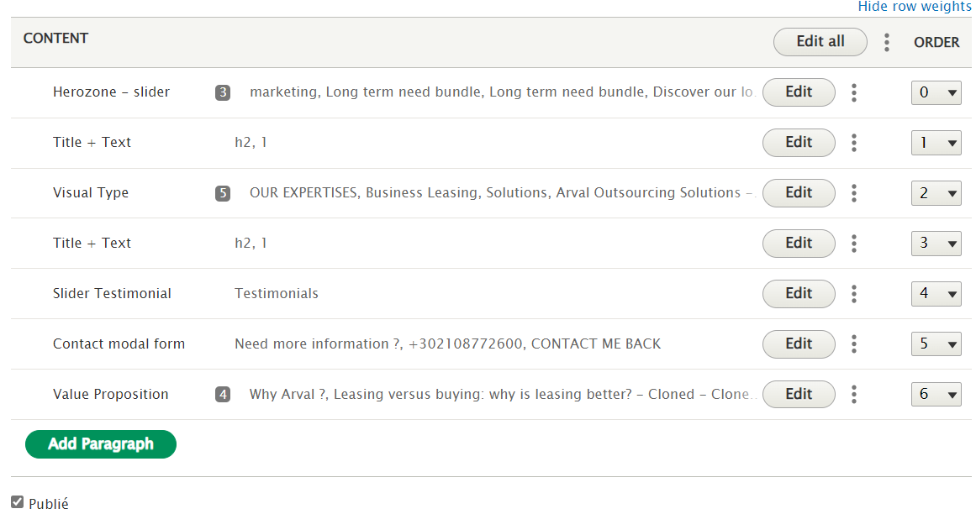
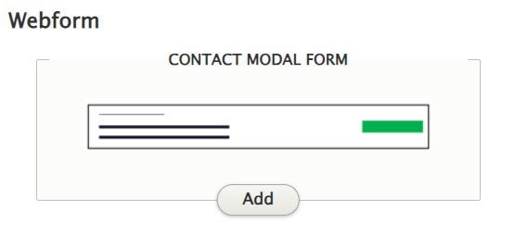
How to phone accessibility
Add a paragraph
Use the block “Contact Modal Form”
HOW TO PHONE ACCESSIBILITY
2

Slide 3
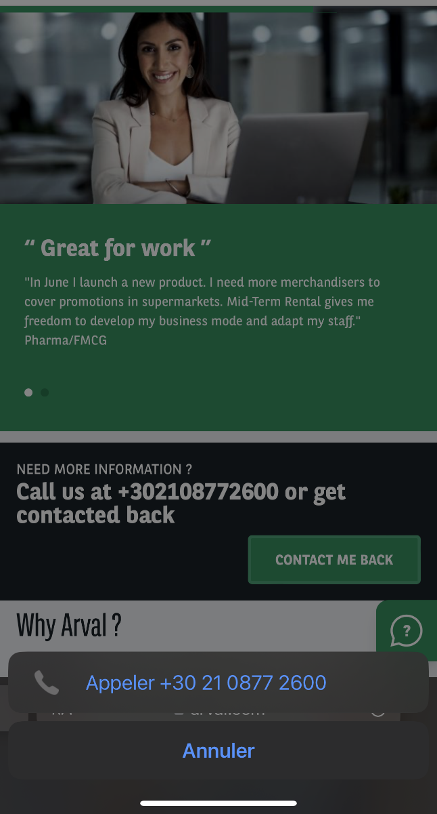
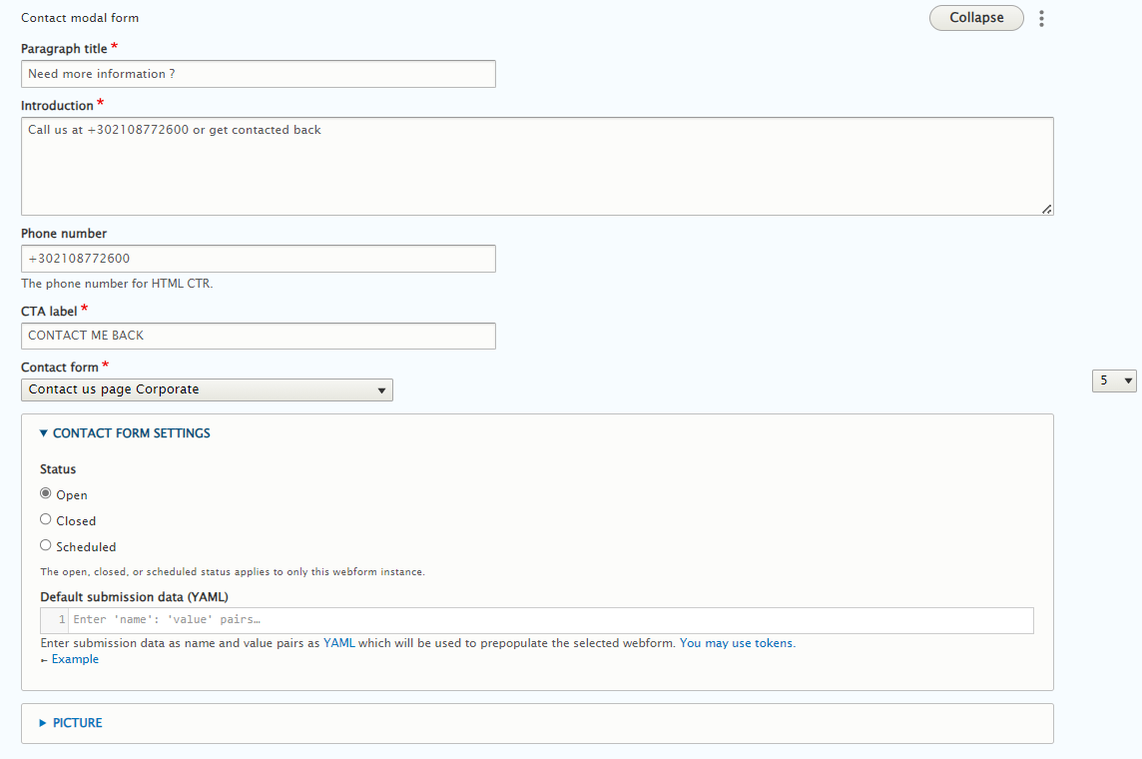
How to phone accessibility
Put the number in the field “Phone Number”
HOW TO PHONE ACCESSIBILITY
3

