Slide 1
HOW TO MANAGE A PARAGRAPH?
Summary

Slide 2
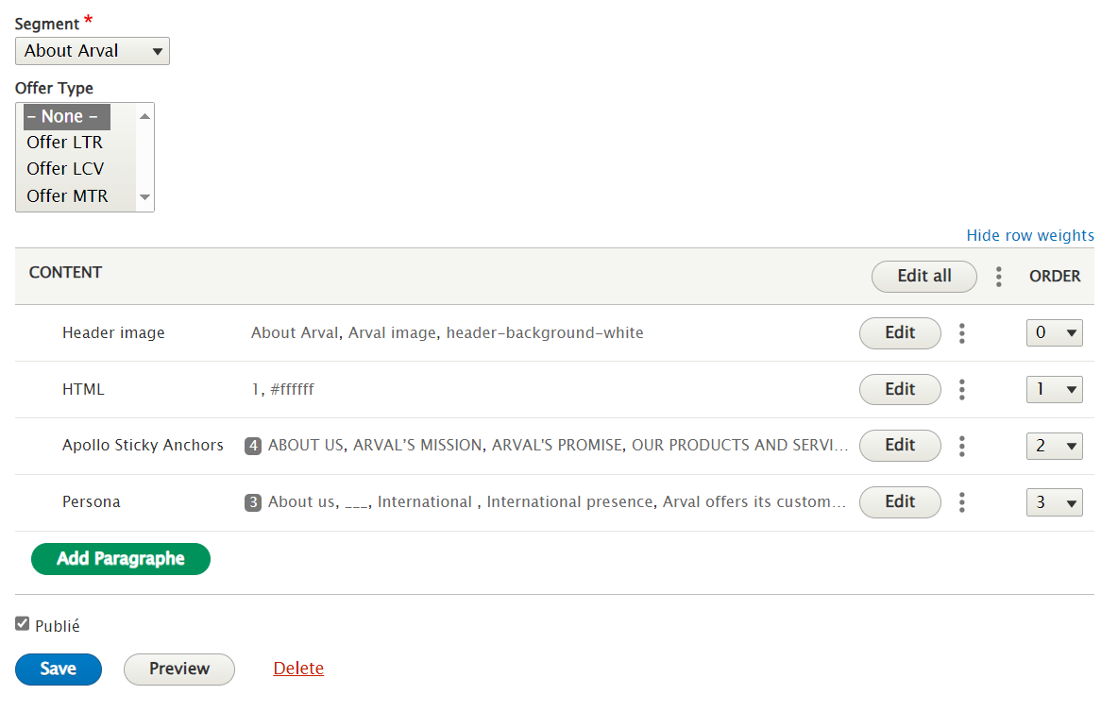
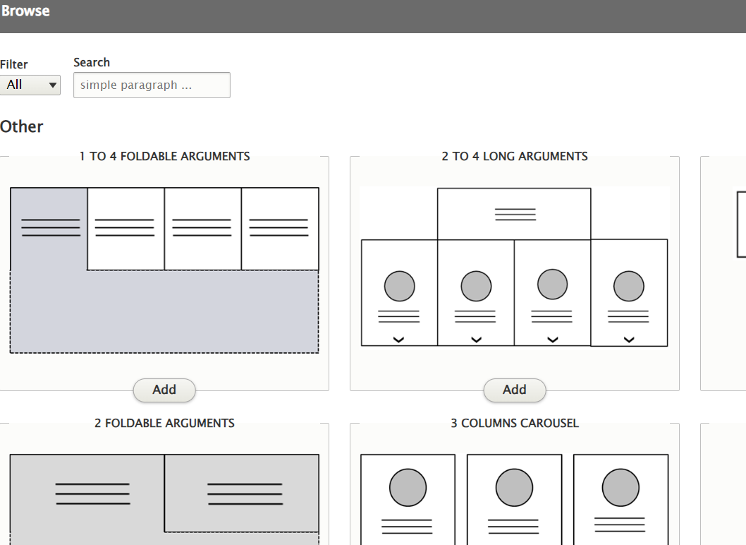
How to manage a paragraph
On yourcontent.
Click on «Add paragraph» to select a paragraph in the list.
Full-filled the paragraph and save the page.
HOW TO DELETE OR MODIFY PDF
2

Slide 3
How to manage a paragraph
After adding the paragraph.
You can manage the order by the numbers.
HOW TO DELETE OR MODIFY PDF
3

