Slide 1

HOW TO DELETE OR MODIFY PDF?
Summary

Slide 2
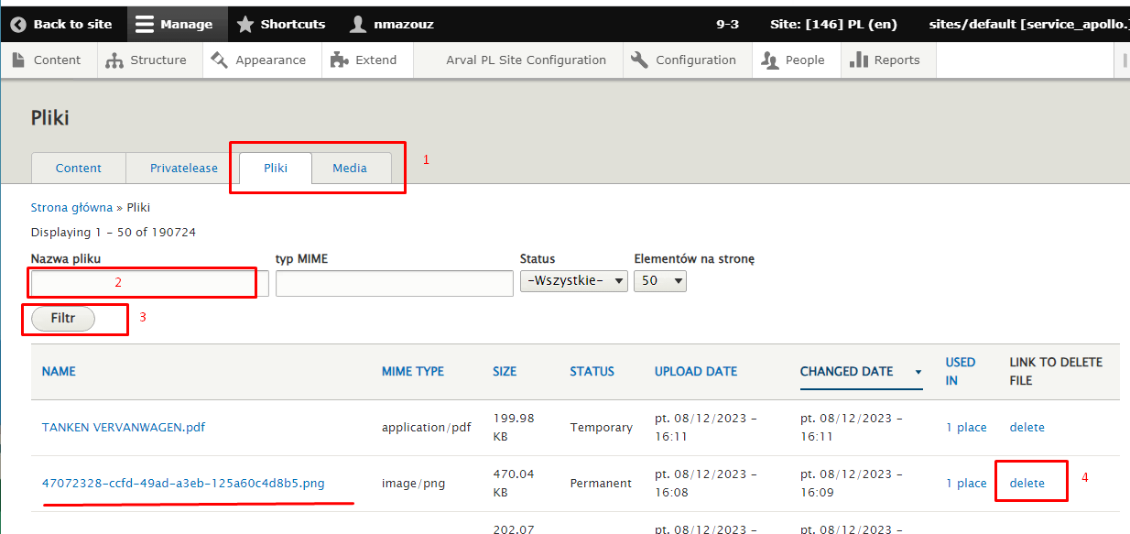
How to delete or modify pdf
You can manage media directly in the media library.
Go in Manage > Content, then two tabs are available: part 1
File: List all the available files, you can search for a specific file, click on filter then choose to delete it, if you want to delete it completely from the media library
HOW TO DELETE OR MODIFY PDF
2

Slide 3
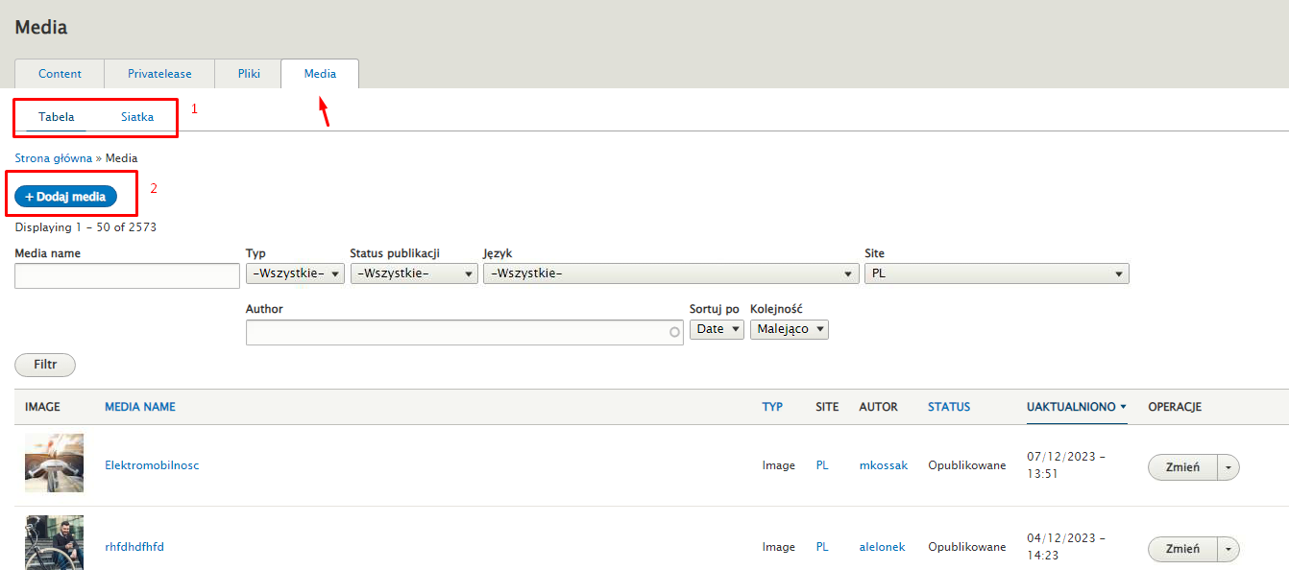
How to delete or modify pdf
Media: Managing of visuals + add new media such as PDF file
1. Display in list or grid
2. Adding a new media
HOW TO DELETE OR MODIFY PDF
3

Slide 4
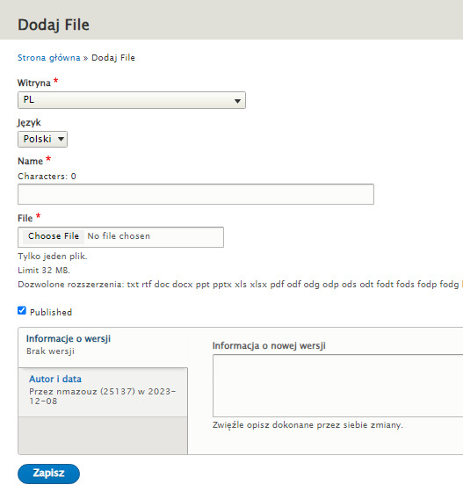
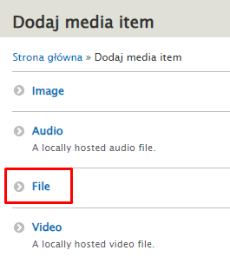
How to delete or modify pdf
If you choose to upload a new media, you will have the possibility to add you new file and save its properties
HOW TO DELETE OR MODIFY PDF
4

Slide 5
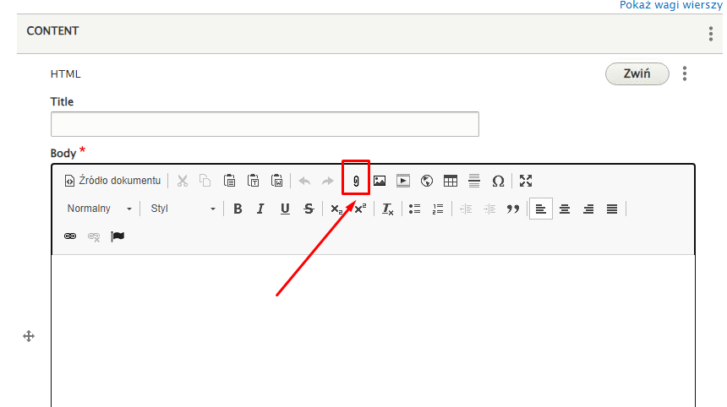
How to delete or modify pdf
B. You can manage media directly into a specific page on which to download it.
By adding an HTML block, and use the file icon from the Rich Text Editor
HOW TO DELETE OR MODIFY PDF
5

Slide 6
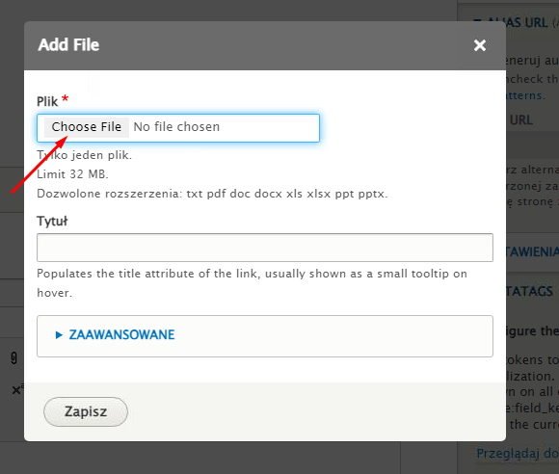
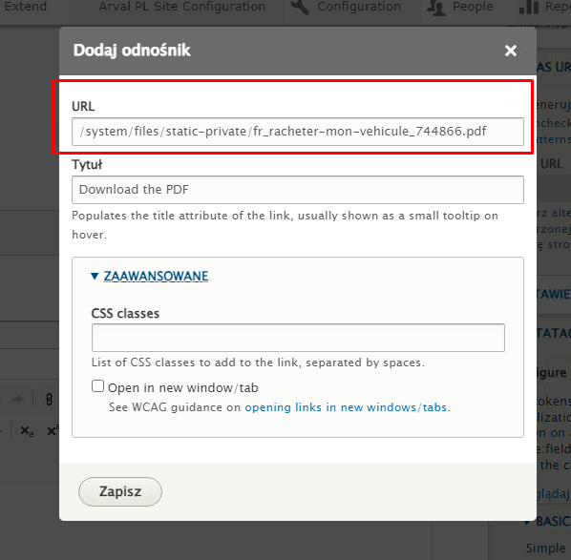
How to delete or modify pdf
This will let you upload the PDF you want directly into your page.
In case you already uploaded your PDF (following the previous steps in the media library), you can use the "add link" icon from the rich text editor and enter the relative path in the url field.
HOW TO DELETE OR MODIFY PDF
6

