Slide 1

HOW TO CREATE A HOMEPAGE?
Summary

Slide 2
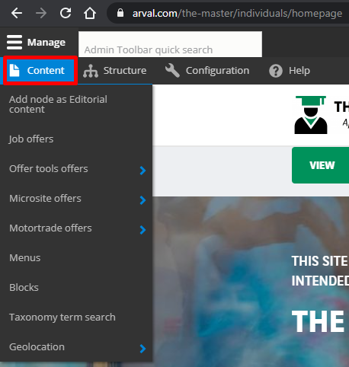
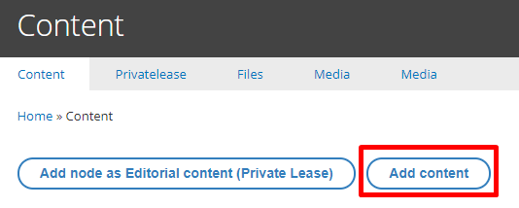
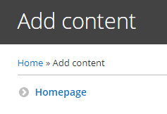
How to CREATE A HOMEPAGE?
Click on “Content” -> “Add content” -> Homepage
URL: /node/add/homepage
PRESENTATION NAME
2

Slide 3
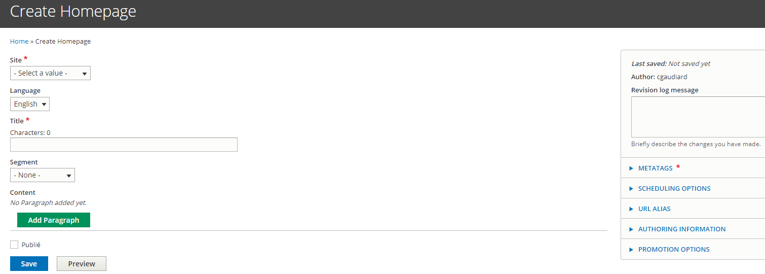
How to CREATE A HOMEPAGE?
All fields with red star are mandatory
Click on “Add paragraph” to add a layer
/!\ Once the Homepage is created you must raise a Jira ticket to set it as default on your website /!\
PRESENTATION NAME
3

