Slide 1
Change Emails/Handlers
Summary

Slide 2
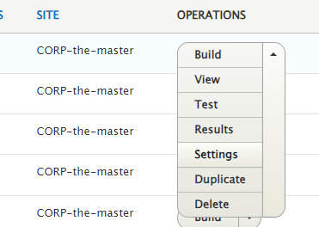
CHANGE emails/handlers
1. In structure menu select « Webforms »
2. Choose the webform that you want to modify
And click on settings
HOW TO DELETE OR MODIFY PDF
2

Slide 3
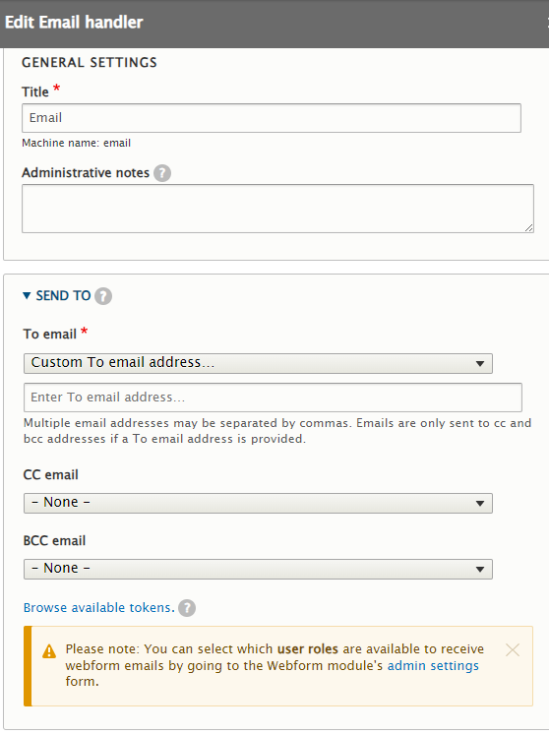
Change emails/handlers
3. Go to the Emails/Handlers tab then you can edit the mail

Slide 4
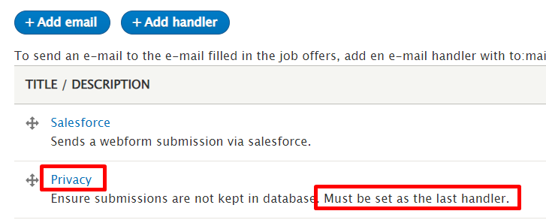
Change emails/handlers
To display the fillers information (email address, name and surname) and the good time submission
! The handler "privacy" must always be placed at the last position. After fixing this all the data should be sent.

