Slide 1
HOW TO ADD AN ANCHOR IN A PAGE
Summary

Slide 2
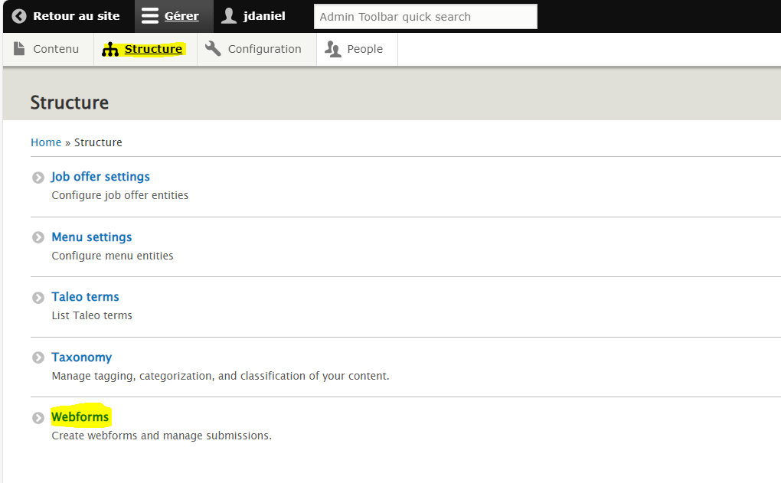
How to ADD AN ANCHOR IN A PAGE
Go in Structure and click on Webforms
HOW TO DELETE OR MODIFY PDF
2

Slide 3
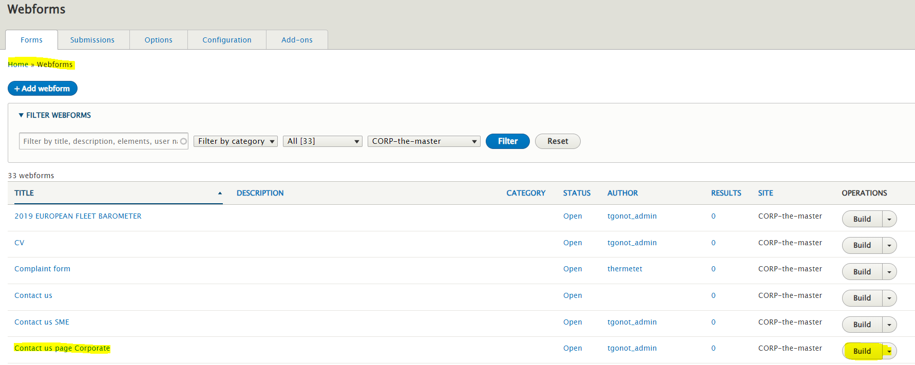
How to ADD AN ANCHOR IN A PAGE
Choose your Webforms and click on Build
HOW TO DELETE OR MODIFY PDF
3

Slide 4
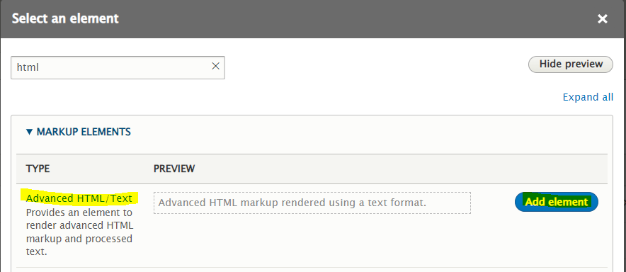
How to ADD AN ANCHOR IN A PAGE
Add element “Advanced HTML/Text”
HOW TO DELETE OR MODIFY PDF
4

Slide 5
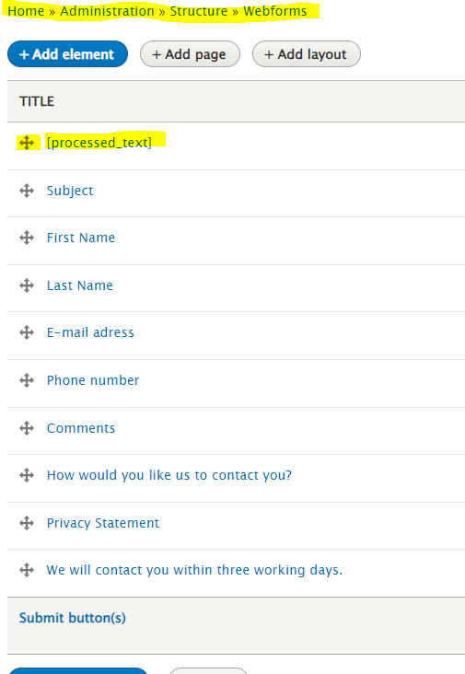
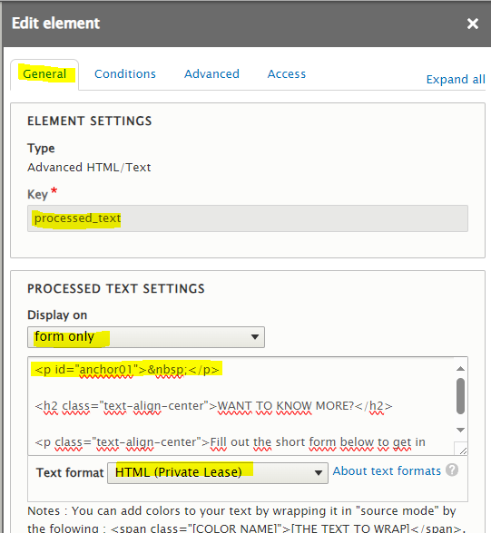
How to ADD AN ANCHOR IN A PAGE
Follow these settings and save. The element “processed_text” must be in first position
<p id="anchor01">&nbsp;</p>
HOW TO DELETE OR MODIFY PDF
5

Slide 6
How to ADD AN ANCHOR IN A PAGE
Go back to editing the page on which you want to set the anchor and add it the URL section
HOW TO DELETE OR MODIFY PDF
6

