Slide 1
How to implement a banner via gtm
Incident on website

Slide 2
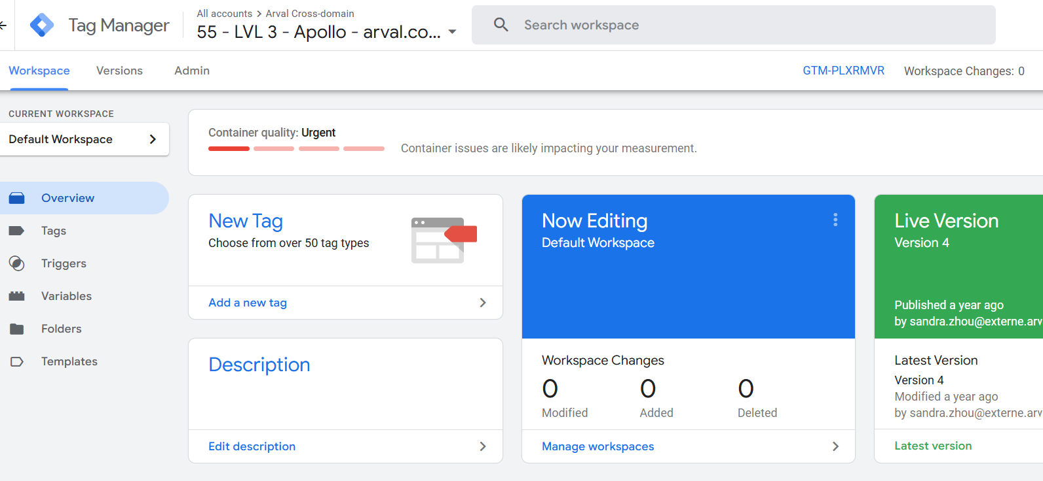
public websites | incident management
1
Connect to GTM
Log In GTM on Google Tag Manager and access your LVL3 container for your local website
2
Create a new tag and set its triggering
3
Configure your tag
4
Preview and test
5
Finalize
6
Until next time
2

Slide 3
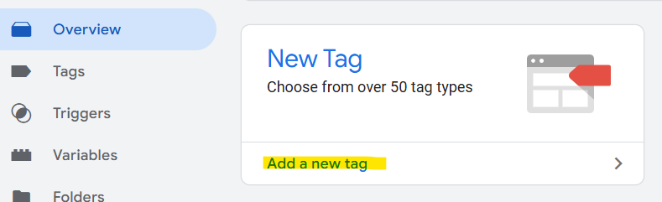
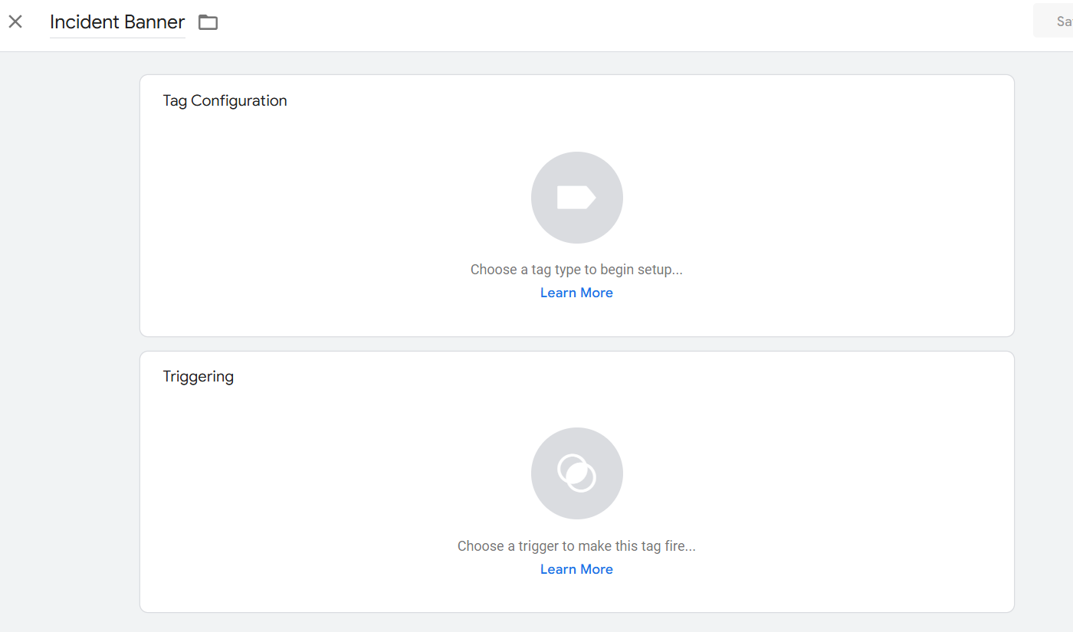
public websites | incident management
1
Connect to GTM
2
Create a new tag and set its triggering
a. Name to your tag
3
Configure your tag
4
Preview and test
5
Finalize
6
Until next time
b. Click to set the triggering rules
3

Slide 4
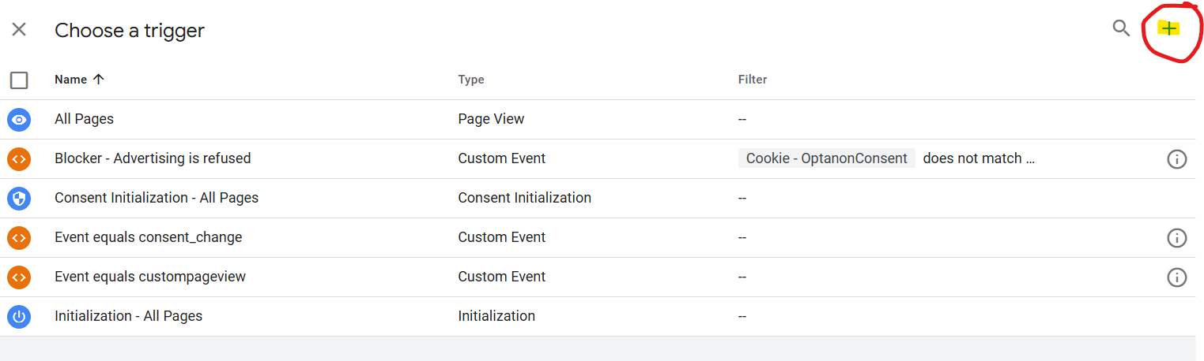
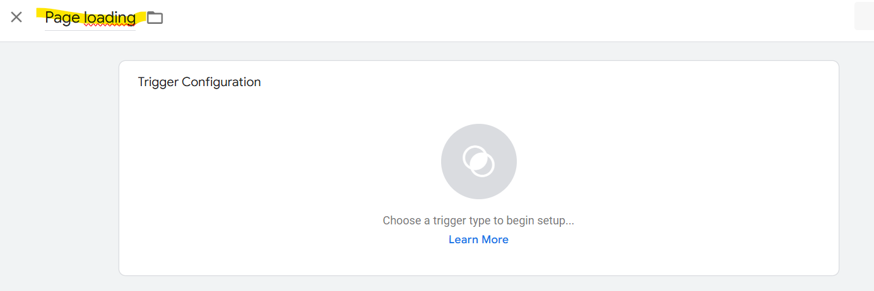
public websites | incident management
The below trigger list is pre set but we want the warning banner to appear on each page of the website therefore we need to add a new trigger (click on the +)
1
Connect to GTM
2
Create a new tag and set its triggering
3
Configure your tag
Name your trigger and click to select a new trigger
4
Preview and test
5
Finalize
6
Until next time

Slide 5
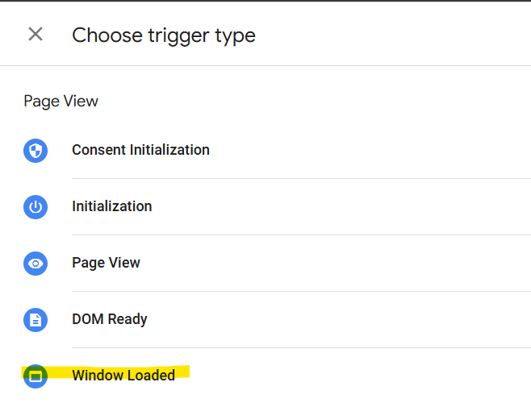
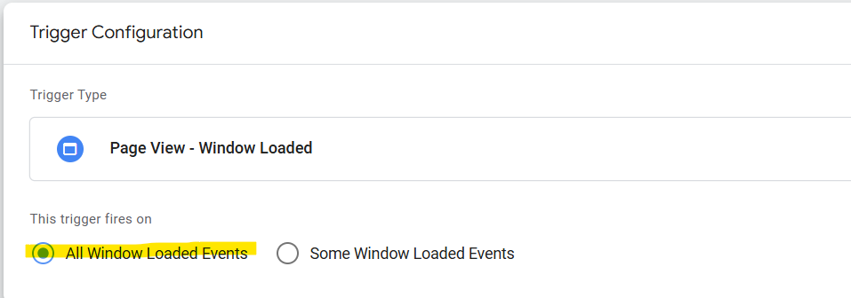

public websites | incident management
Select « Window loaded » and « All window loaded events » to make sure the banner show on each loaded page
1
Connect to GTM
2
Create a new tag and set its triggering
3
Configure your tag
4
Preview and test
5
Finalize
6
Until next time
Make sure to save

Slide 6
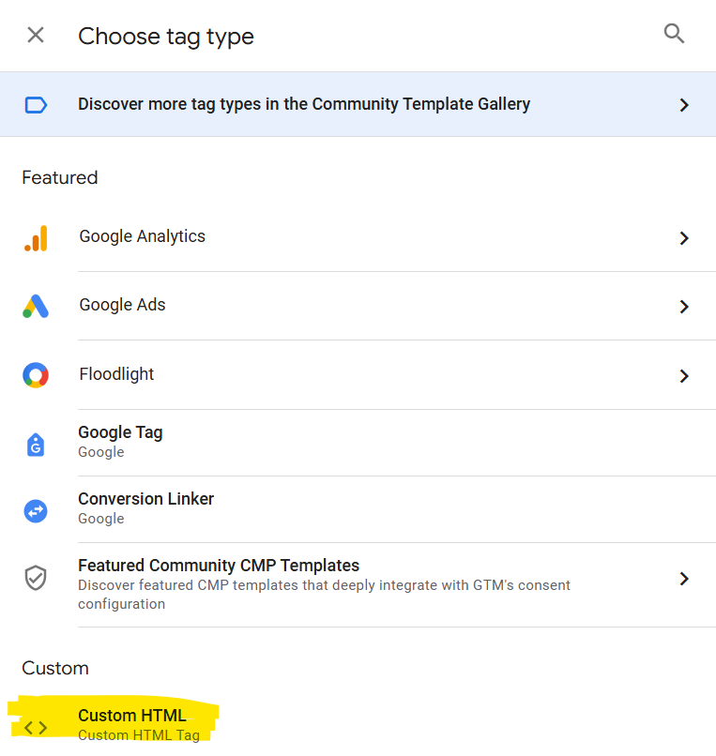
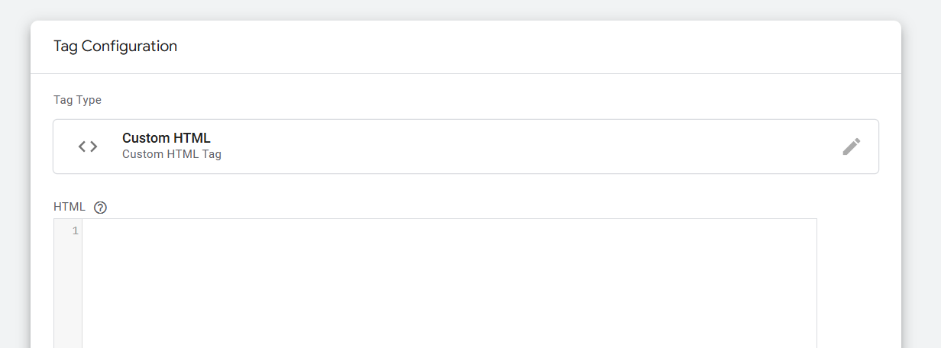
public websites | incident management
Click on the Tag Configuration block and add a custom HTML tag
1
Connect to GTM
2
Create a new tag and set its triggering
3
Configure your tag
4
Preview and test
5
Finalize
On the HTML section add the below code and adapt the text to your needs
<script>
var wrapper = document.getElementsByTagName("body");
wrapper[0].insertAdjacentHTML('afterbegin', "<div style='padding: 20px; color:#ffffff; text-align: center; width: 100%; background-color:orange; display: block;'>Due to technical issues our webforms are not working and some webpages are not loading. Thank you for your patience.<br></div>");
</script>
6
Until next time

Slide 7
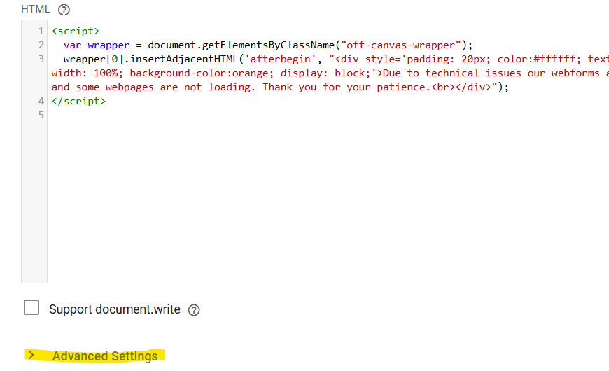
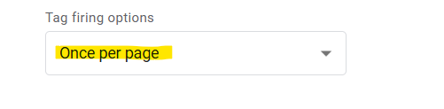
public websites | incident management
Once the code is in place go to « Advanced settings » to adjust the firing option to « Once per page »
1
Connect to GTM
2
Create a new tag and set its triggering
3
Configure your tag
4
Preview and test
5
Finalize
6
Until next time
Make sure to save

Slide 8
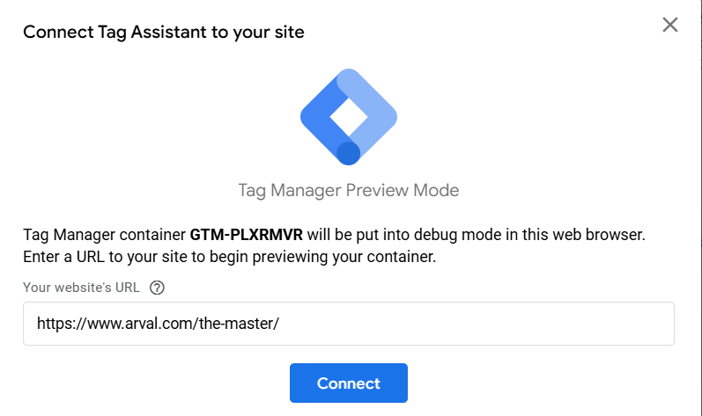
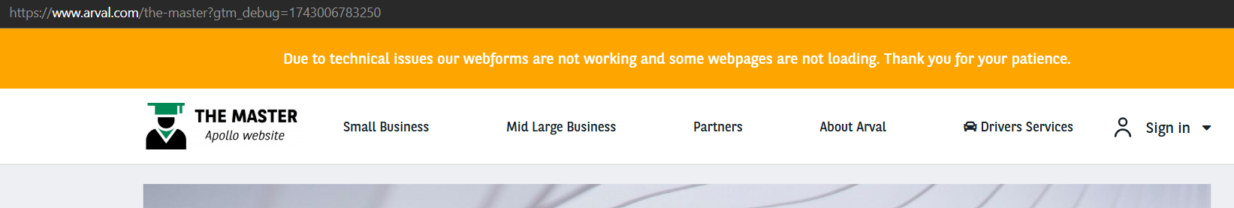
public websites | incident management
Use the « Preview » CTA and connect the assistant to your website
1
Connect to GTM
2
Create a new tag and set its triggering
3
Configure your tag
4
Preview and test
5
Finalize
6
Until next time

Slide 9
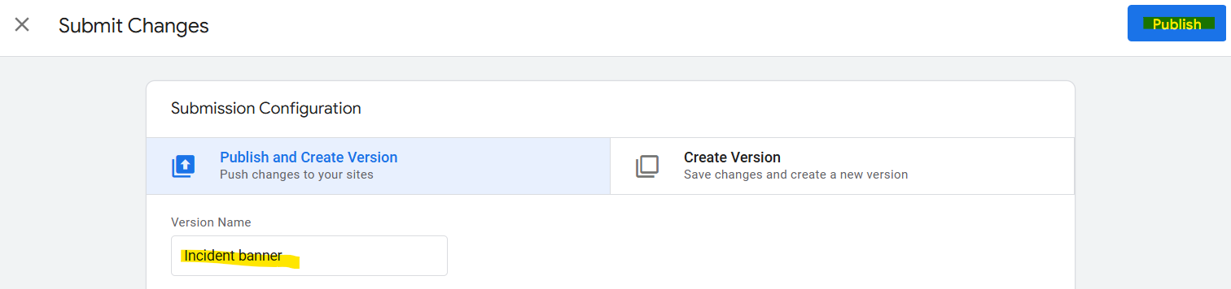
public websites | incident management
Go back to GTM and « Submit » to confirm the change
1
Connect to GTM
2
Create a new tag and set its triggering
Publish to see it in production
3
Configure your tag
4
Preview and test
5
Finalize
6
Until next time

Slide 10
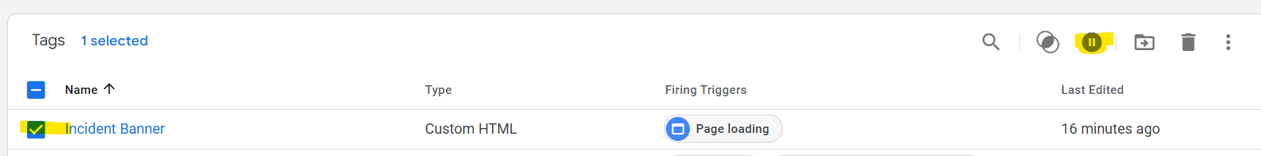

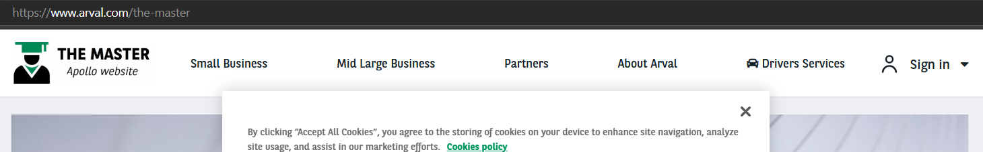
public websites | incident management
Incident is over? Pause the trigger
1
Connect to GTM
2
Create a new tag and set its triggering
Publish to see it in production
3
Configure your tag
4
Preview and test
5
Finalize
6
Until next time

Slide 11
Thank you

