Slide 1
CREATE A MARKETING CAMPAIGN
Drupal 8
User guide
October 2020

Slide 2
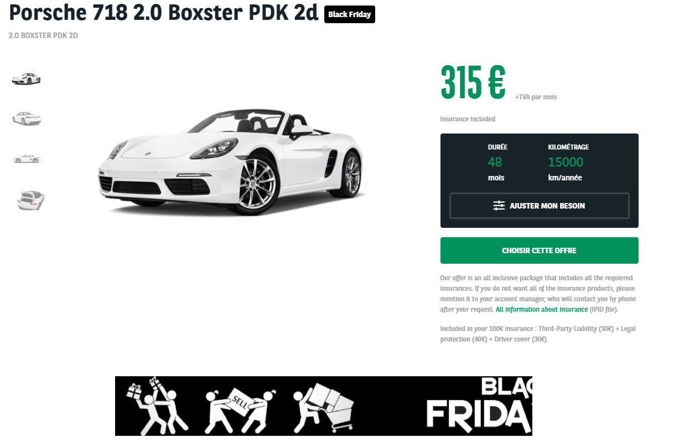
Step 1 : Creating graphical elements
Offer page :
Banner : 728x90px

Slide 3
Step 2 : Asking for the creation of the Salesforce campaign
Make a request by mail to your local Salesforce contact for the creation of the campaign
You will receive an Campaign ID, unique by campaign and by countries
For example, for the BlackFriday 2019 campaigns:
Campaign ID for Netherlands: 7012X000001LaK1QAK
Campaign ID for Spain: 7012X000001LaJrQAK

Slide 4
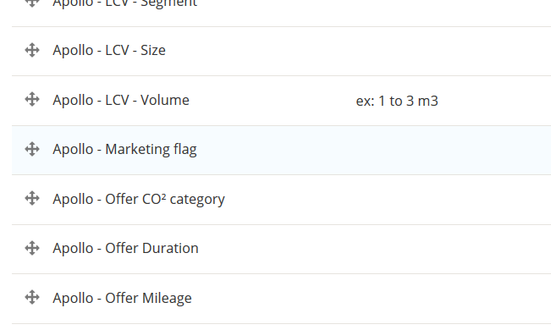
Step 3 : Creating the marketing tag
The marketing tag allows you to visually flag your offers from the campaign and to identify it in Salesforce
1/ Search the taxonomy : Marketing Flag
2/ Add a new term

Slide 5
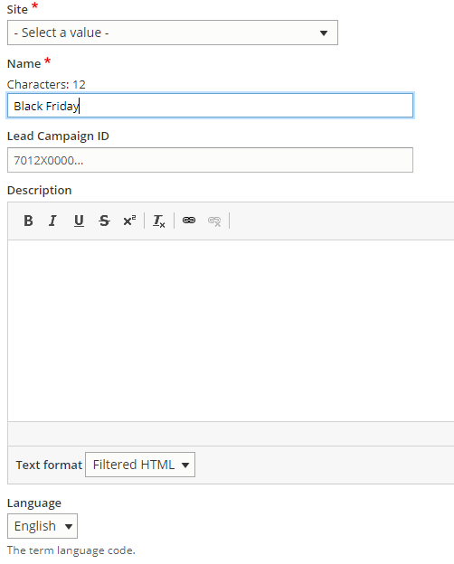
Step 3 : Creating marketing tag
1/ Choose your site
2/ Add a title of the campaign (this title will appear on the client interface)
3/ Add the Campaign ID you received from Salesforce Team
4/ Description is not mandatory
5/ Set the language of taxonomy
(will be the site language)

Slide 6
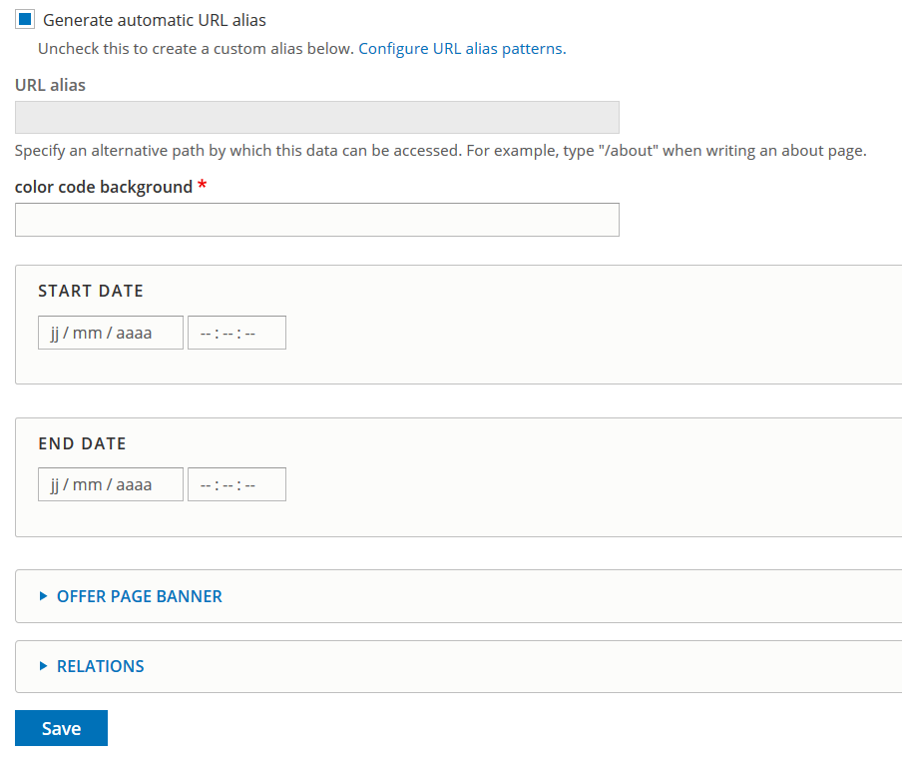
Step 3 : Creating marketing tag
5/ Let the checkbox check
6/ Url alias will be create automaticaly
7/ Choose the background color :
Hexa code : #xxxxxx
8/ Add the start date and hour of the campaign*
9/ Add the end date and hour of the campaign*
10/ Add the banner yu created on step 1 which will be displayed in the offer page
11/ Relations : do not touch
12/ Click on save
* For now, the back office is on GTM 0, so you need to take it into account in your settings.
For example: if you want to launch a campaign in Spain on the 29/11 at 14:00, you need to set your start time at 13:00 in the tool.
!

Slide 7
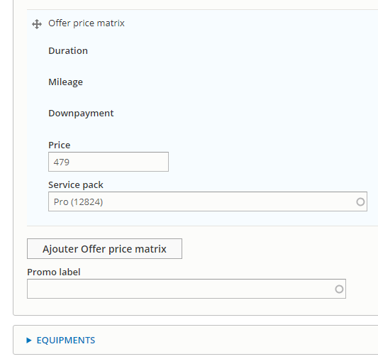
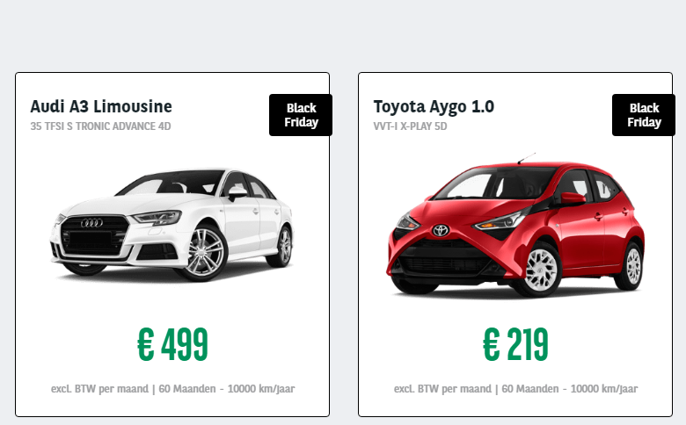
Step 4 : Promote to front offers
1/ In all your offer pages from the campaign, fullfield the « Promo Label » field with the name of the campaign
(this field will be renamed by Marketing flag at the end of November, it won’t have any impact on your modification)
By doing this step, your offer will be flagged for the campaign and contoured (the contouring is only applied when the campaign is opened, the flag is always applied)

Slide 8
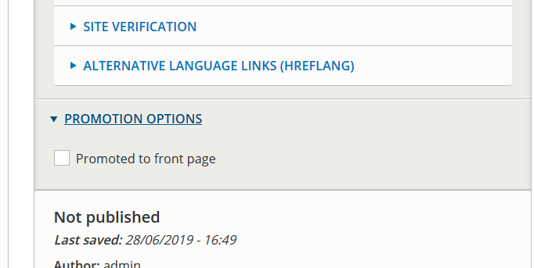
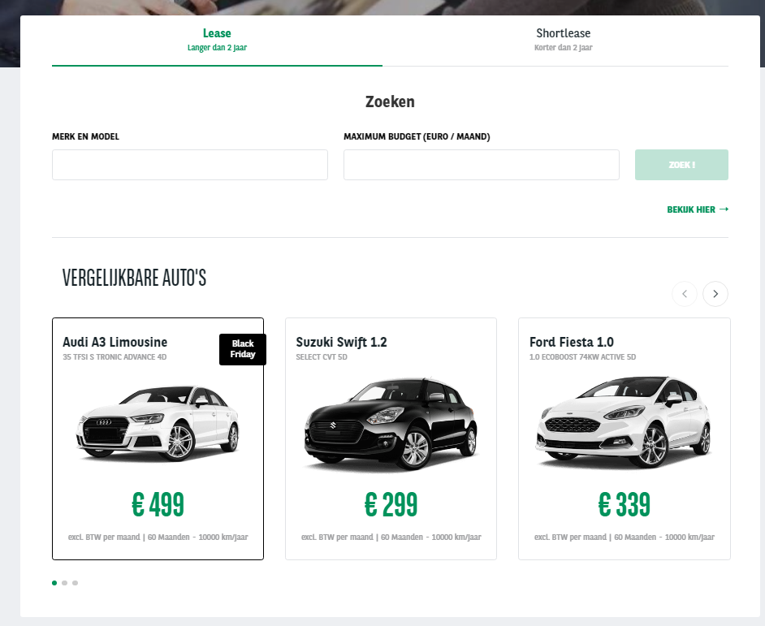
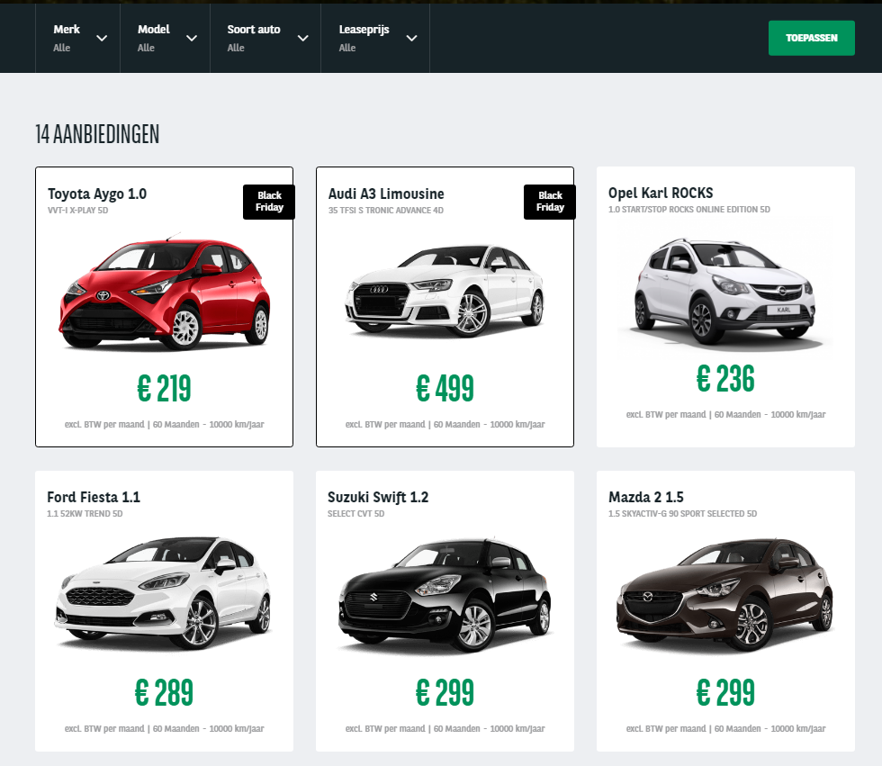
Step 4 : Promote to front offers
2/ In the offer page, go to the bottom of the page, in the right module, in the area « Promotion Options » :
check the checkbox « Promoted to frontpage »
By doing this action, it will put your offer on the top of the result list, as well as on the top of the slider paragraph just below the search block

Slide 9
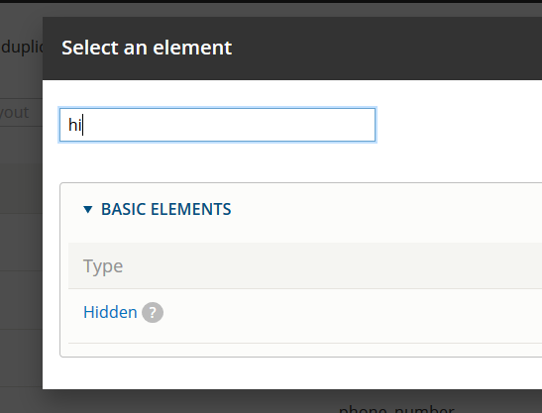
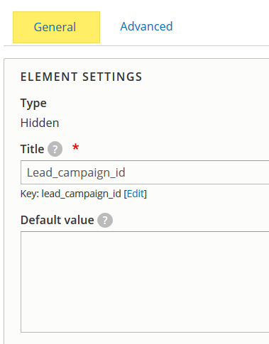
Step 5 : Linking to Salesforce (webform)
In the webform you will used (both for the Landing page and for your Funnel), add a “hidden” field
Fullfield the title with the Drupal key : “Lead_campaign_ID”
Let the “Default value” empty
Save
Make sure the 6 hidden fields below are already on your webform. If not, please check on the page 10 to 17 of this user guide)

Slide 10
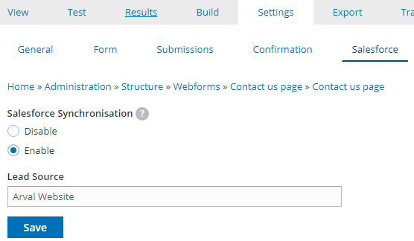
Step 5 : Linking to Salesforce (webform)
In the webform “Settings >> Salesforce”, enable the link to SF
Full field the Lead Source with Arval Website
Save

Slide 11
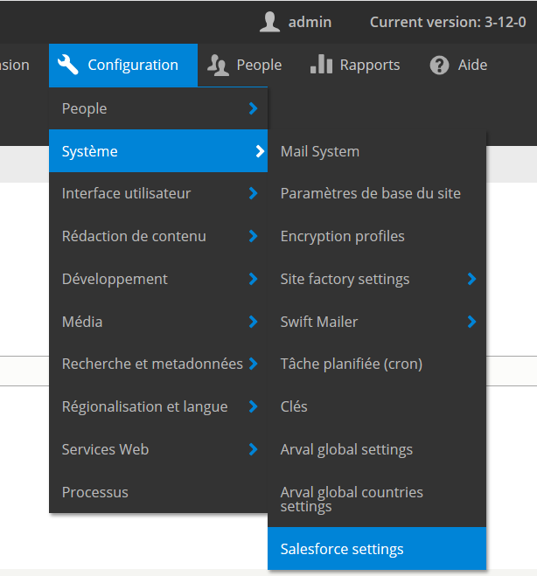
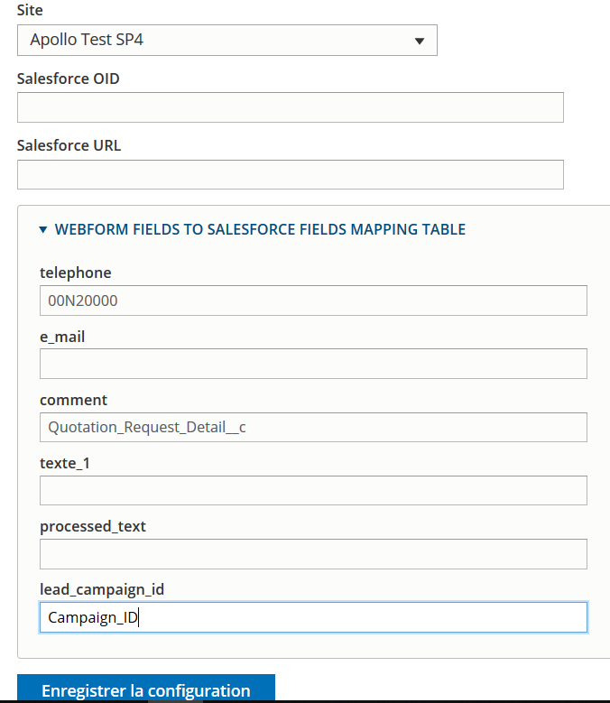
Step 5 : Linking to Salesforce (webform)
In the site “Configuration >> System >> Salesforce settings”, fullfield the “lead_campaign_id” with the SF key : “Campaign_ID”
Save

